Slide 1
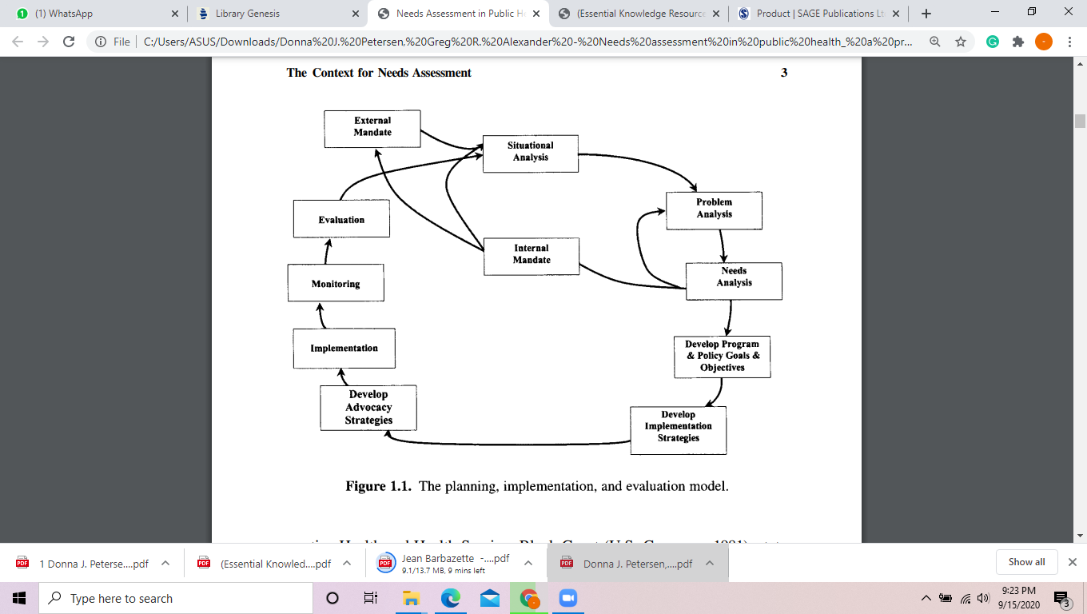
Proses management program PNF

Slide 2
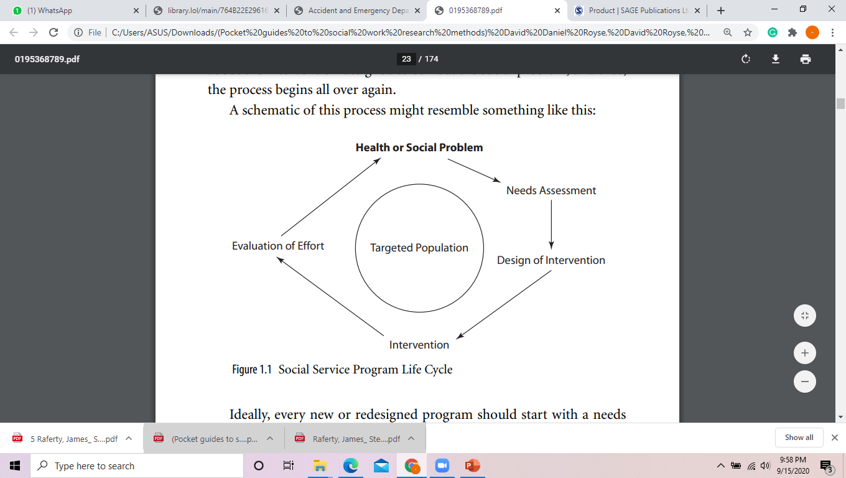

Slide 3
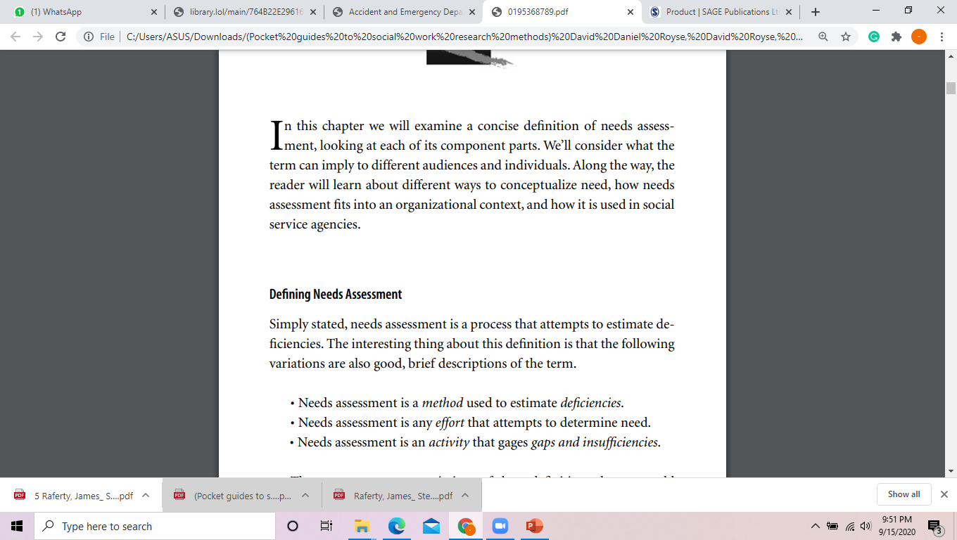
Needs assesment

Slide 4
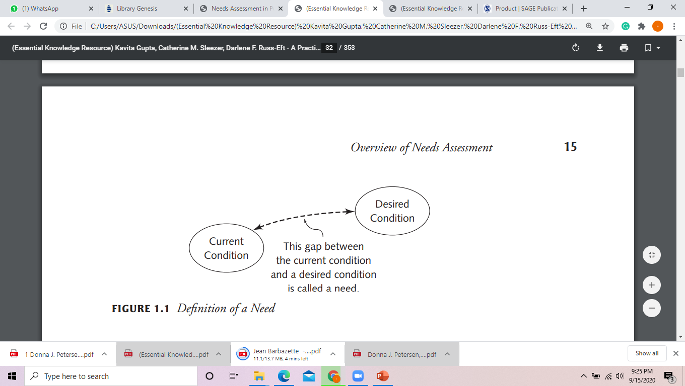

Slide 5
Jenis Kebutuhan..
The use of experts or key informants (persons well-positioned in a community to know about it and its problems—sometimes formed into a “blue ribbon” study group) is a particular type of needs assessment methodology or approach known as normative need.
Expressed need is based on an examination of clients’ requests for service.
Felt need is the category Bradshaw applied to efforts that directly ask clients what they believe or feel that they need. This is the form of needs assessment that best captures the clients’ perspective. Generally speaking, clients would be surveyed or interviewed to learn about their felt needs.
Comparative need is similar to case finding… examines the characteristics of those receiving services from a program or agency and then looks for these characteristics elsewhere in the population to extend service and estimate the “true” amount of need if there were no barriers

Slide 6
Kegunaan
Securing Resources/Establishing the Need for New Efforts
Modification of Policy
Improving Services
Establish or Strengthen Partnerships

Slide 7
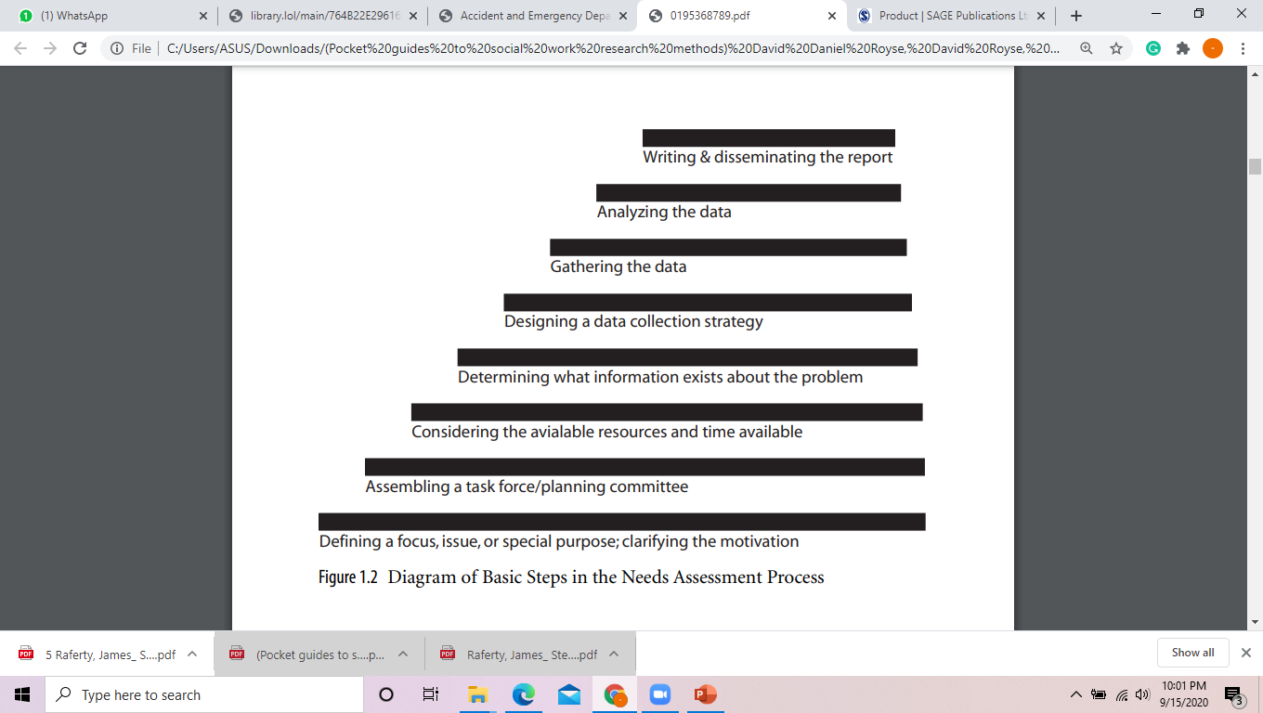

Slide 8
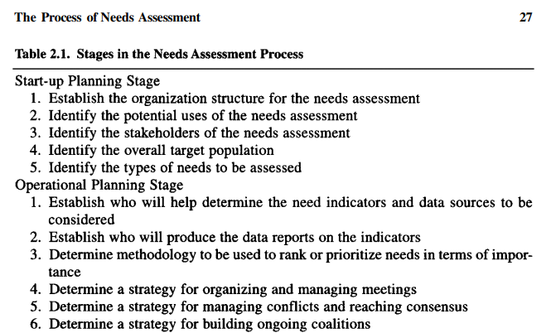

Slide 9
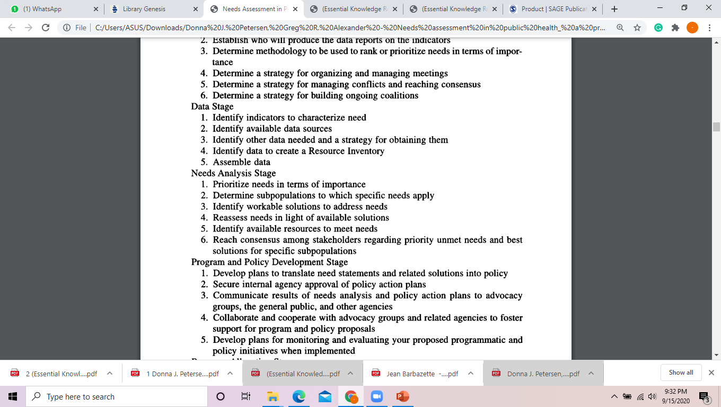

Slide 10
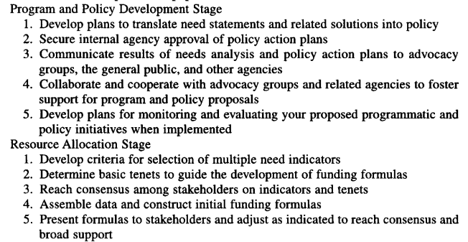

Slide 11
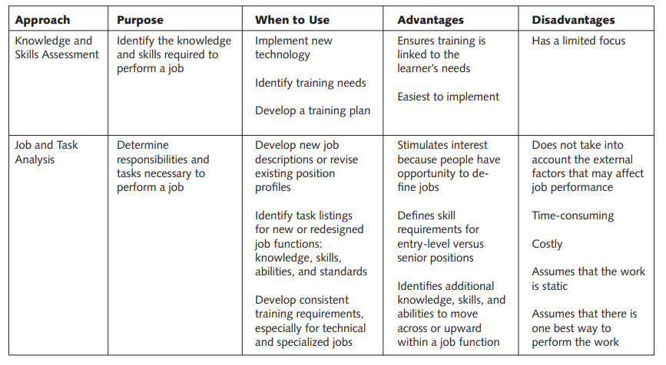
Pendekatan NA

Slide 12
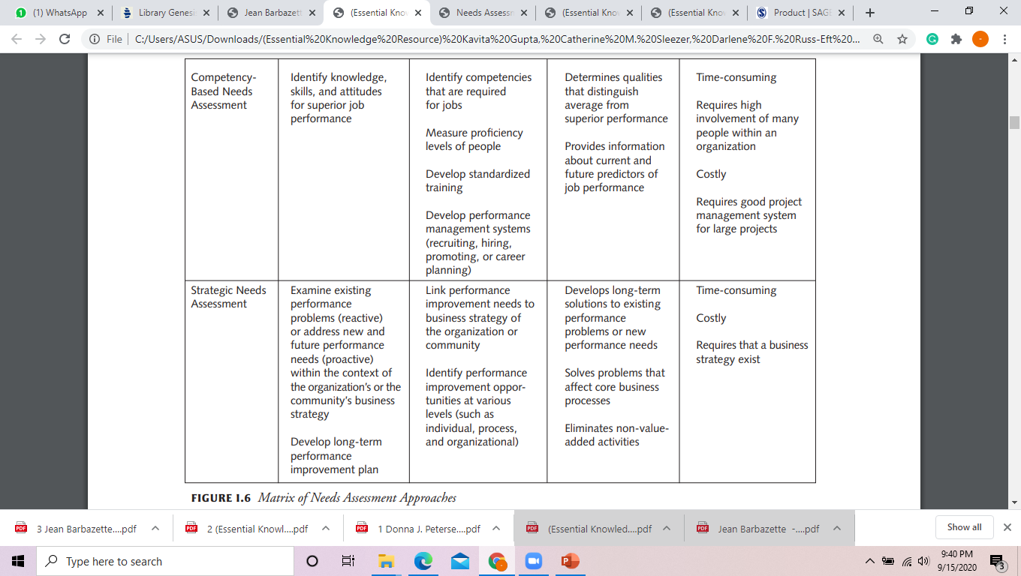

Slide 13
Isi Program = Kompetensi - Prasyarat
Pamong desa: agar efektif, akuntabel, bermakna, professional
- Layanana masy (kognisi, afeksi, pskomotor)
Mendukung masy (kognisi, afekti, psikomotor)
Mediasi masy
Kognisi : memahami fungsi media; memahami mitra; memahmi prinsip layanan prima, dll.
Afeksi: peduli, terbuka, dll
Psikomotor: lobbying, komunikasi, mampu multicara/TIK, dll
Mengontrol kegiatan masy (kognisi, afeksi, psikomotor)

Slide 14
Siapa/kelompok sasaran strategis: yang potensial dikembang
Pekerjaan/peran:
 | Aspek kompensi
Kompentensi | kognisi | afeksi | psikomotor
1………………..…
2………………….
3……………………
4………………...

Slide 15
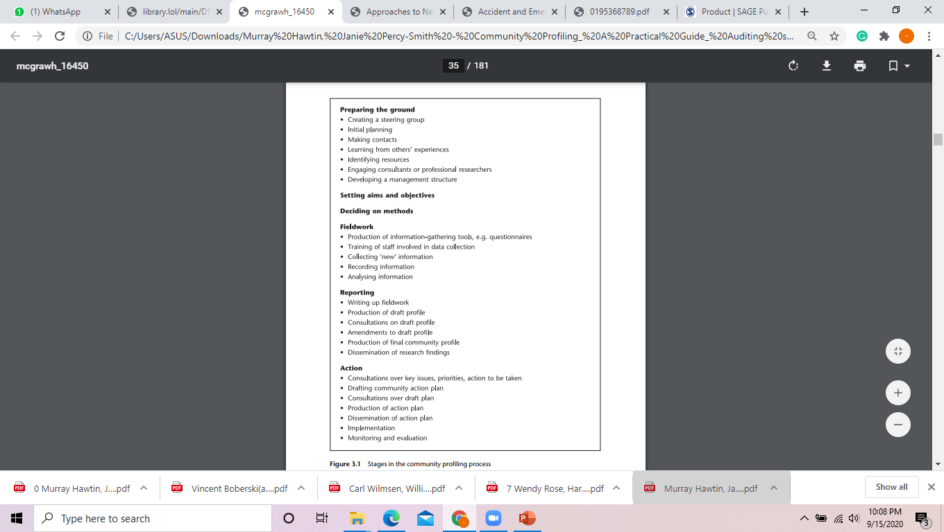
Langkah community profiling

Slide 16
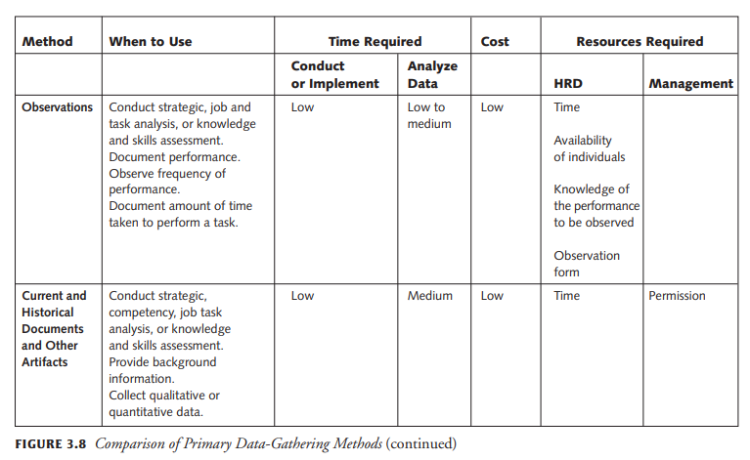

Slide 17
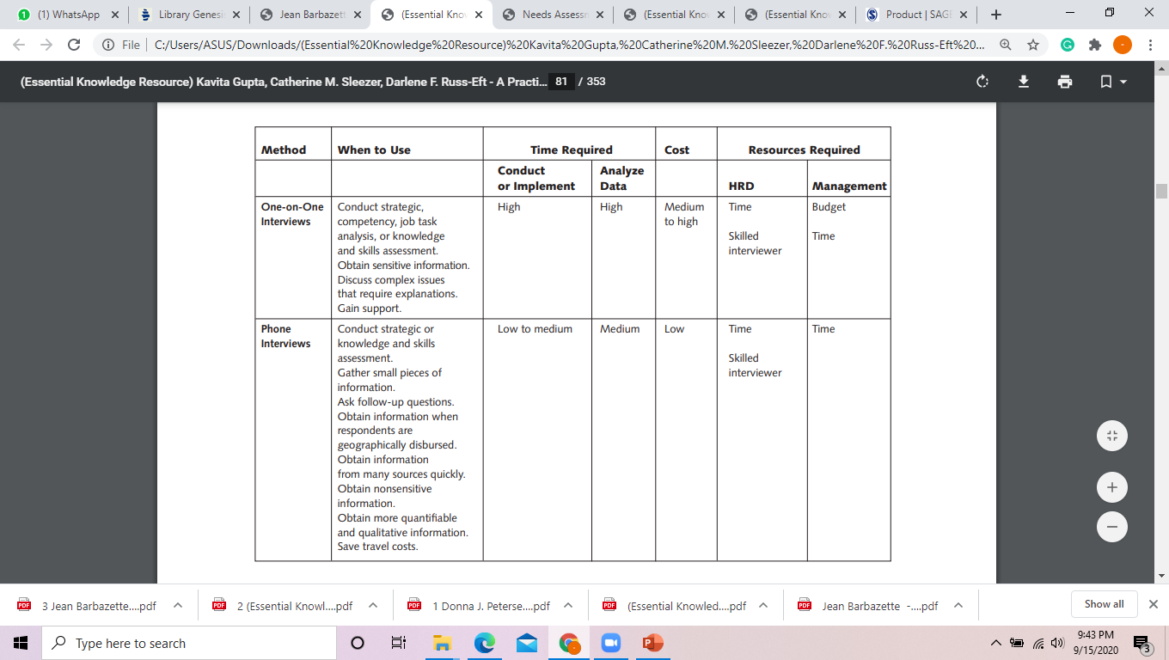
Metode pengumpulan data

Slide 18
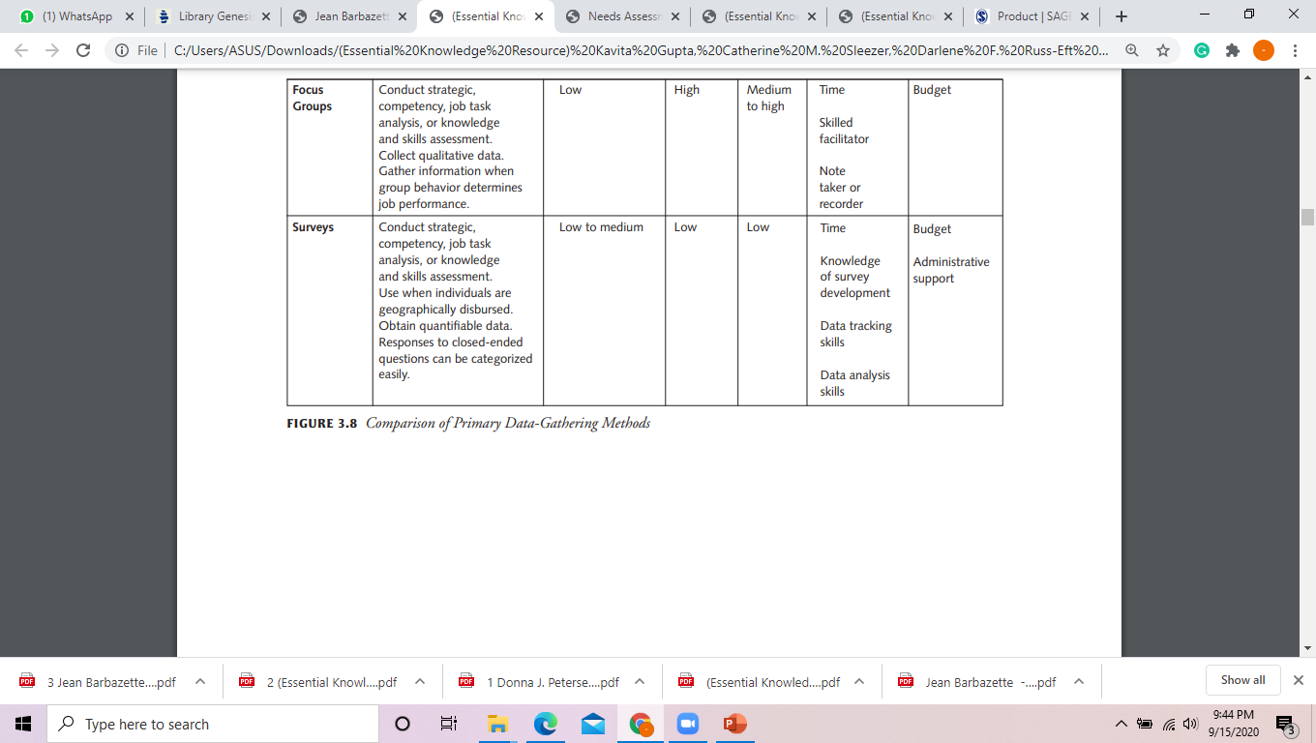

Slide 19
Perumusan Strategi
Faktor Internal Faktor Eksternal | Kekuatan (S) .................. .................. ............... dst. | Kelemahan (W) .................. .................. .................. dst
Peluang (O) 1 ................... 2. .................. 3. .................. | STRATEGI S-O | STRATEGI W-O
Tantangan (T) .................. ................... .................. | STRATEGI S-T | STRATEGI W-T

Slide 20
