Slide 1
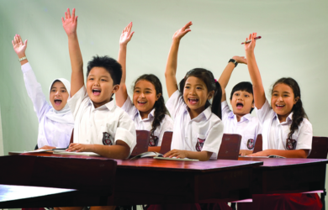
MEMAHAMI PEMBELAJAR

Slide 2

INDIVIDUAL DIFFERENCES
ADAPTIVE TEACHING
INTELLIGENCE
THE EFFECTS OF INTELLIGENCE ON LEARNING
THE EFFECTS OF CULTURAL DIFFERENCE ON LEARNING
THE EFFECTS OF PERSONALITY AND LEARNING STYLE
THE EFFECTS OF THE PEER GROUP ON LEARNING
THE EFFEECTS OF HOME LIFE AND SOCIAL CONTEXT ON LEARNING

