Slide 1
Data Collection Methods

Slide 2
What is data?
Or to be more accurate, what are data? [Data is plural!]
The data you collect are the evidence for your research, and it is the basis upon which you can make claims about the answer/s to your research question.
As with every aspect of research, it is important to be systematic about your data and how and when you will collect it.
This is why it is part of the process of research design.
There are numerous possibilities for methods of data collection, and sometimes you have to think about creating a particular kind of dataset to suit your research. But some of the most common methods are addressed in this PPT.

Slide 3
What is Data Collection?
Data collection is a methodical process of gathering and analyzing specific information to proffer solutions to relevant questions and evaluate the results. It focuses on finding out all there is to a particular subject matter. Data is collected to be further subjected to hypothesis testing which seeks to explain a phenomenon.

Slide 4
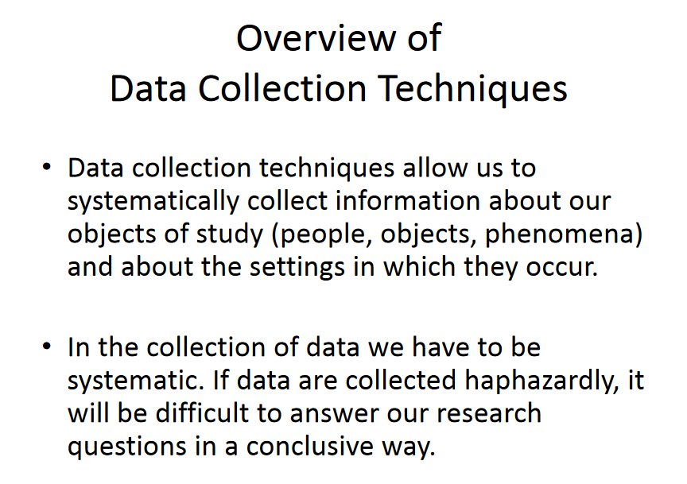

Slide 5
Types of Data Collection
Primary data collection
is the gathering of raw data collected at the source. It is a process of collecting the original data collected by a researcher for a specific research purpose. It could be further analyzed into two segments; qualitative research and quantitative data collection methods.
Secondary data collection
is referred to as the gathering of second-hand data collected by an individual who is not the original user. It is the process of collecting data that is already existing, be it already published books, journals and/or online portals. In terms of ease, it is much less expensive and easier to collect.

Slide 6
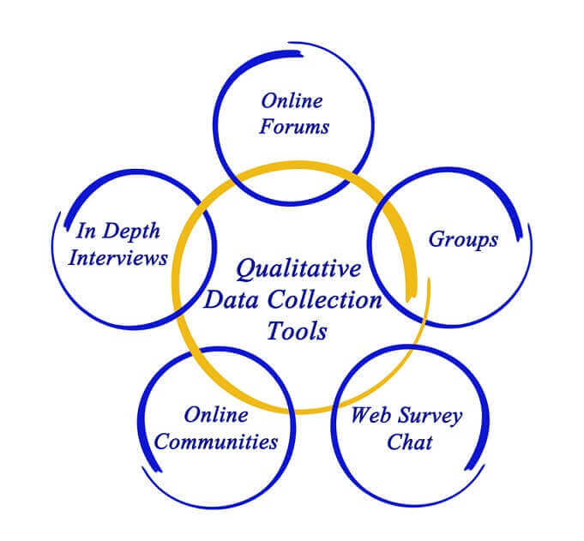
Qualitative Research Method
Discussion

Slide 7
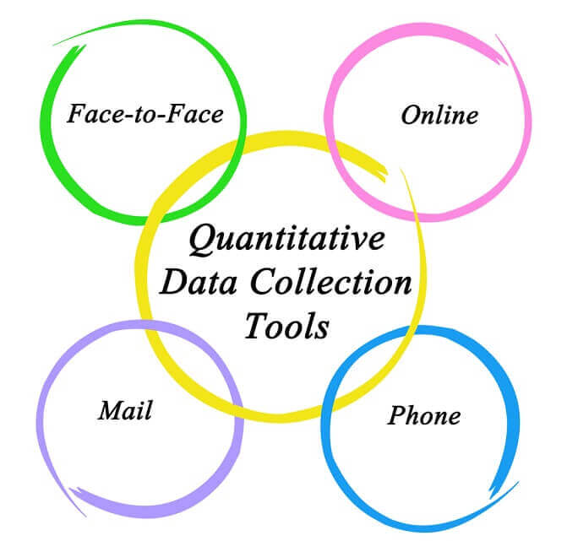
Quantitative Method

Slide 8
Research Instruments
Many of the data collection methods have an accompanying ‘research instrument’ or process for supporting the data collection
Data Method | Research Instrument
Lesson observation | Structured or semi-structured observation schedule
Interviews | Structured, unstructured, or semi-structured interview schedule (opening, intro, main, cool of, closing) / Check list
Questionnaires | Paper or online questionnaire (open, closed, semi)
Documents | Check list
Student work samples | Check list
Test | Subjective / Objective Test (pre/post, formatif/sumatif, paper pencil test /CBT)

Slide 9
Data Collection Methods
Lesson observation: detailed, focused observations of whole lessons, or pre-determined parts of lessons;
Interviews: probing conversations with interviewees to explore their perspectives, thinking, or reactions;
Questionnaires: sets of questions which can be open-ended or closed which seek to elicit the perspectives, thinking, or reactions of participants ;
Documents: the collection of relevant documents , such as historical archives or policy documents;
Student work samples: examples of students’ work, written, oral or observed which provide information about students’ learning or progress ;
Test : progress/performance measures captured ‘before’ and ‘after’ an intervention, or period of time;

Slide 10
GENERAL GUIDELINES IN
PREPARING AN INSTRUMENT
Do a preliminary research by visiting your library or checking online sources.
Talk to a person who is knowledgeable in preparing research instruments.
Master the guidelines in preparing and administering each type of instrument.
Clarify your research questions. Be sure that your instruments will directly address your specific research questions.

Slide 11
GENERAL GUIDELINES IN
PREPARING AN INSTRUMENT
Based on the data you need, decide on the number of people whom you want as respondents or participants.
Prepare the instrument using the appropriate format. Get model instruments, if necessary. You may visit Google Scholar to get samples of your intended instruments.
Edit your instrument.
Pilot your instrument to further improve its quality. After receiving the feedback from your pilot, make the necessary revisions.

Slide 12
Choosing your method
Choosing which data collection method to use is principally about matching the right data method to your research question, for example:
  if you want to understand what teachers, or parents, or students think about something, then interviews are often a good method or deep exploration;
  if you want to know something about classroom practice, either teacher practices or student responses, then classroom observation is useful;
  if you want a large number of responses to gain a perspective on an issue, a questionnaire is useful;
  if you want to examine the effectiveness of an intervention, pre and post test data is useful.
Many research studies collect two or three complementary sets of data eg classroom observation and interviews; or large scale questionnaires followed by in-depth interviews; or pre and post test measures and classroom observation;
If these data collection methods are well-designed and related to the research focus, they provide different spotlights on your research question: this is called triangulation.

Slide 13
Research Instrument Design
The golden rule in creating your research instrument, for example, a semi-structured interview schedule, is that it should be clearly focused on your research question;
You need to be clear what information/understanding/evidence you are trying to elicit;
You should think about the smaller ideas, or constructs, that you are probing through your research instrument;
You should draw, wherever possible on research and theoretical ideas in designing the research instruments.
More guidance on research instruments is available on the website.

Slide 14
Capturing Data
Because most of the data methods described represent a moment in time which cannot be revisited, you need to think about how to capture your data so you can revisit it later for analysis.
Sometimes the research instrument is itself a way of capturing your data, for example a questionnaire or an off-the-shelf test;
But sometimes you need to think about ways to capture your data: audio recording is very useful for interviews; and video data is very useful for classroom observation;
Designing a questionnaire online often cuts out a stage of transferring data on paper into an electronic format so is very useful;
With tests and measures, you will need a clear system for recording the results, probably using EXCEL.
Think about how you will capture your data before you begin data collection!
Think also about the ethics of storing data: especially confidentiality and anonymity.

Slide 15
QUALITATIVE
DATA COLLECTION

Slide 16
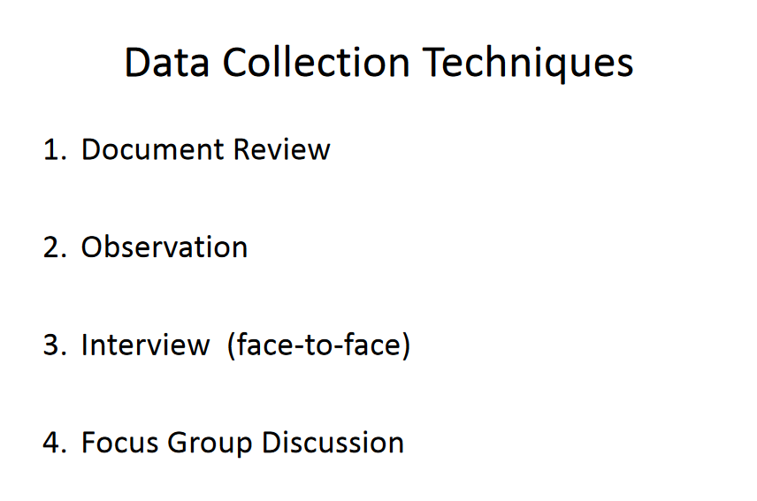

Slide 17


Slide 18
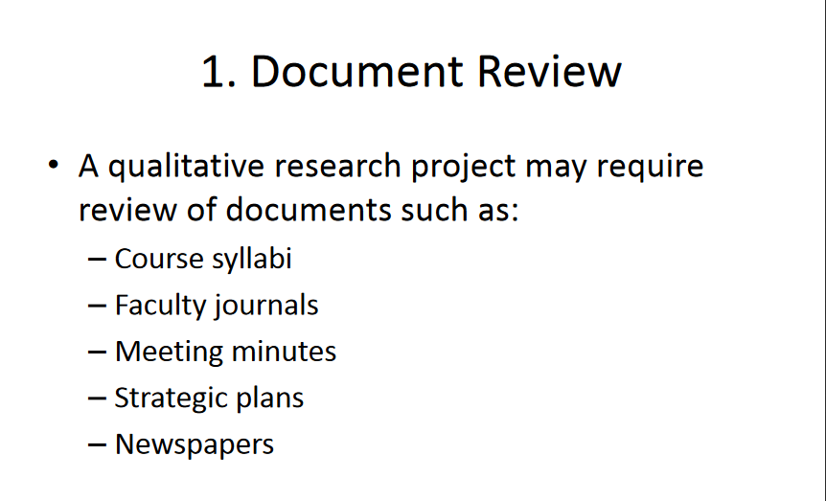

Slide 19
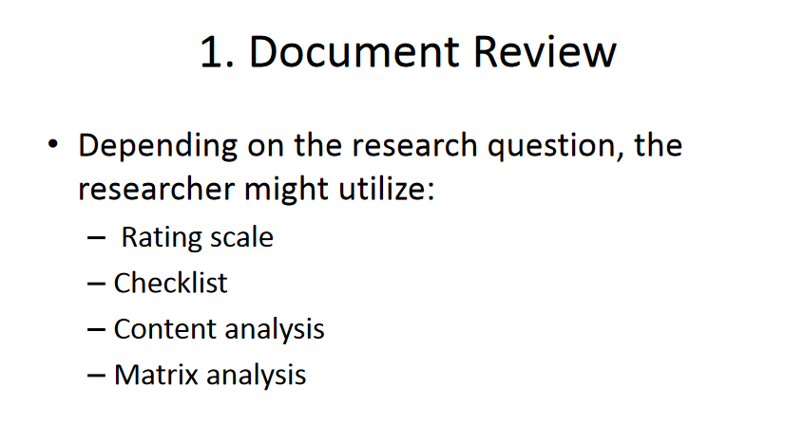

Slide 20
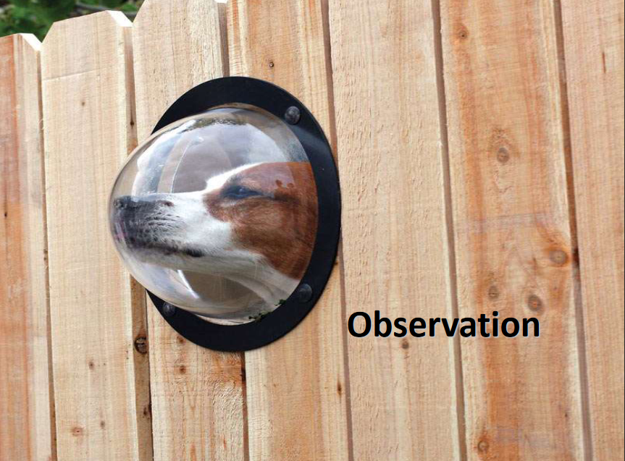

Slide 21
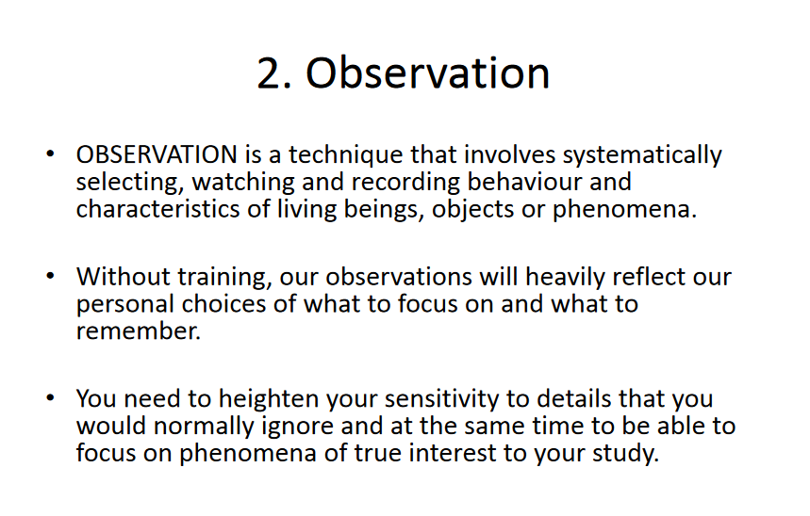

Slide 22
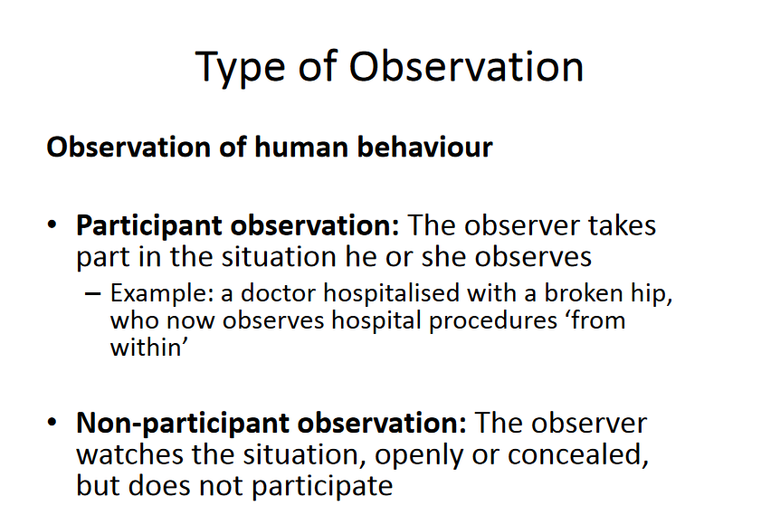

Slide 23
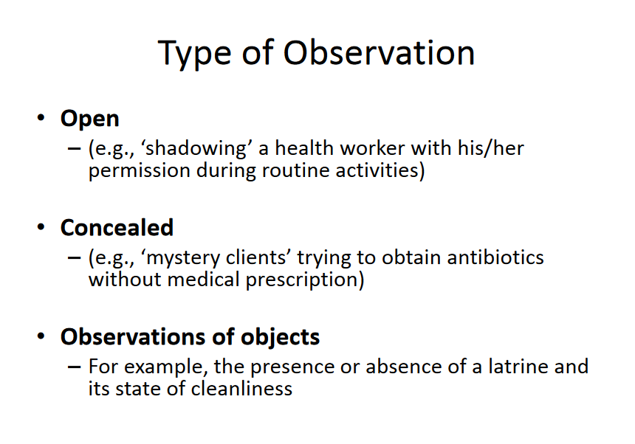

Slide 24
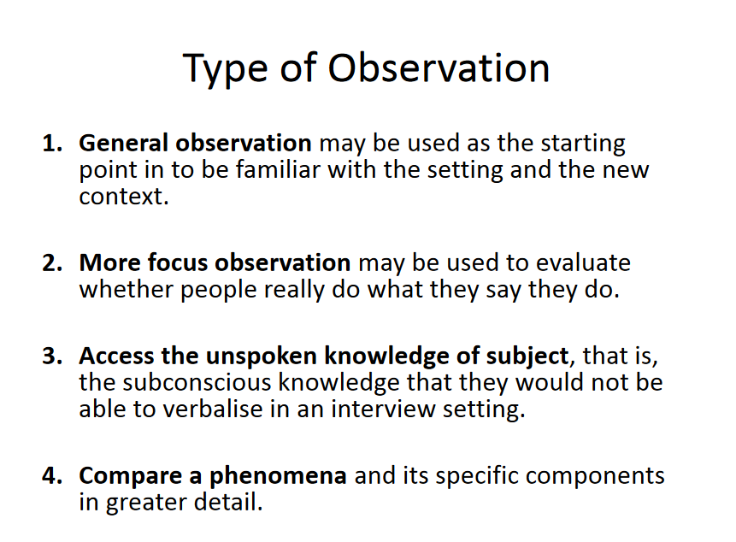

Slide 25
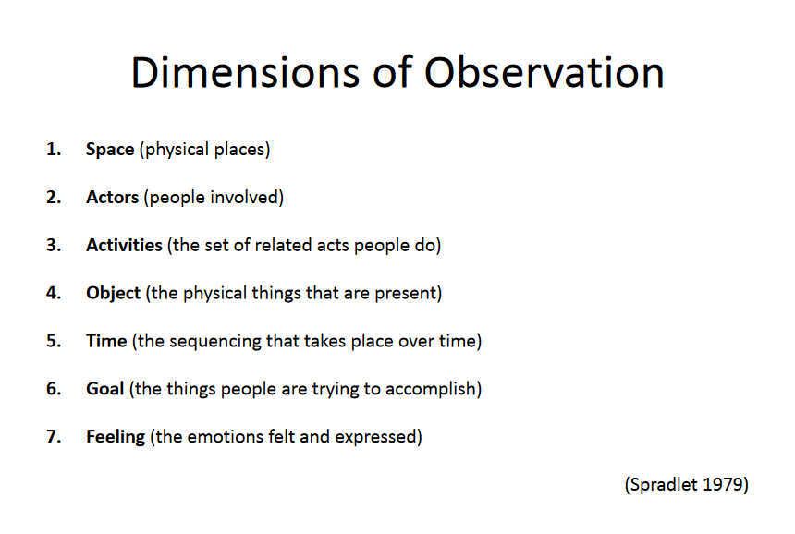

Slide 26
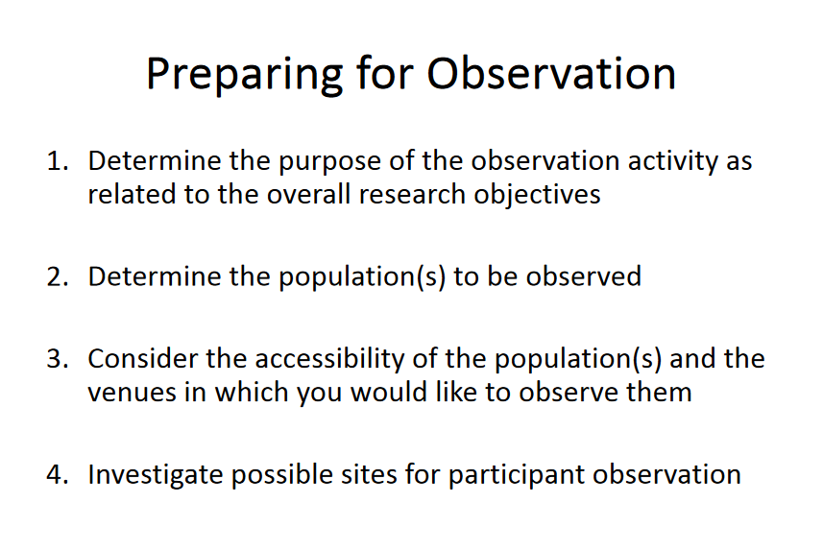

Slide 27
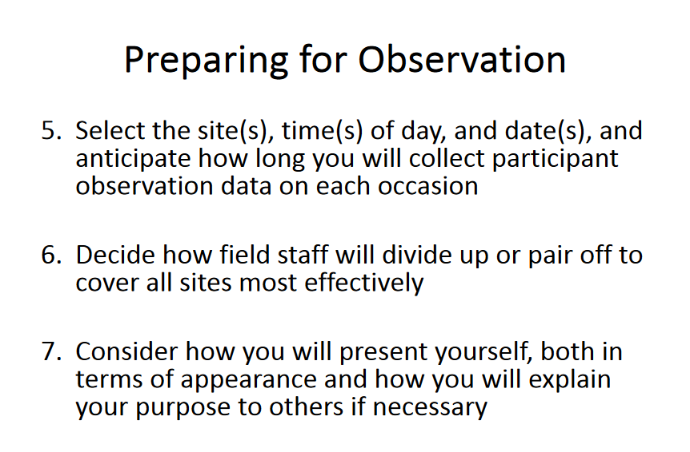

Slide 28
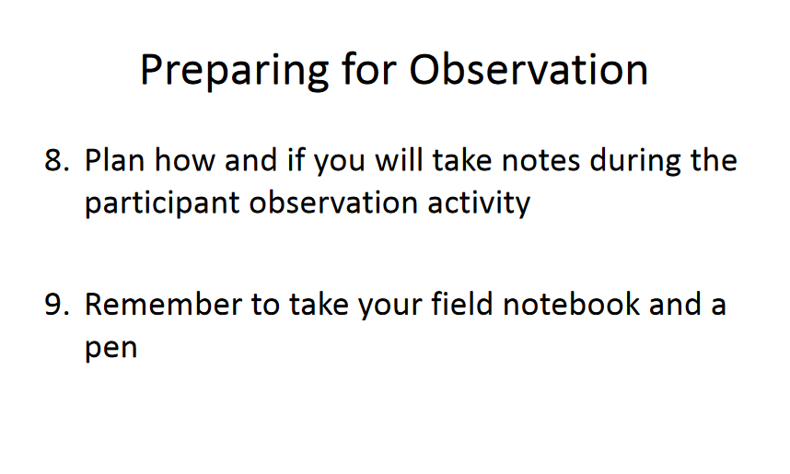

Slide 29
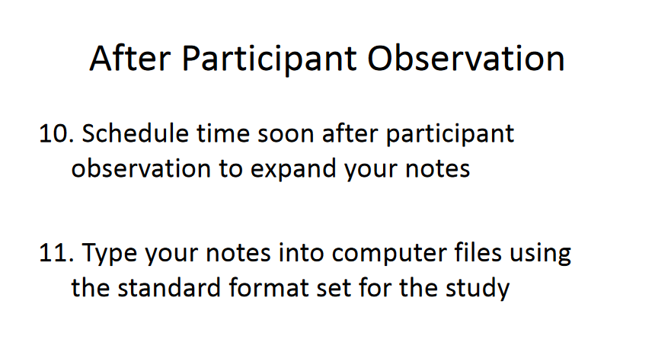

Slide 30


Slide 31
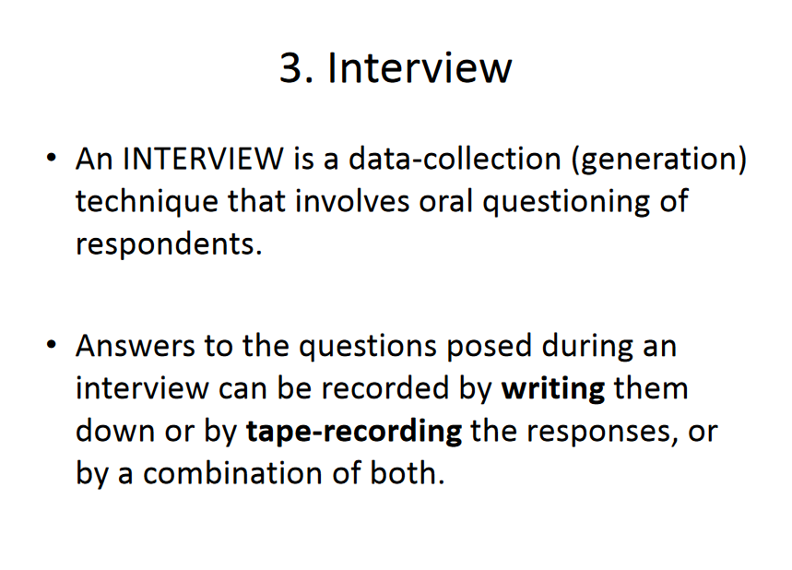

Slide 32
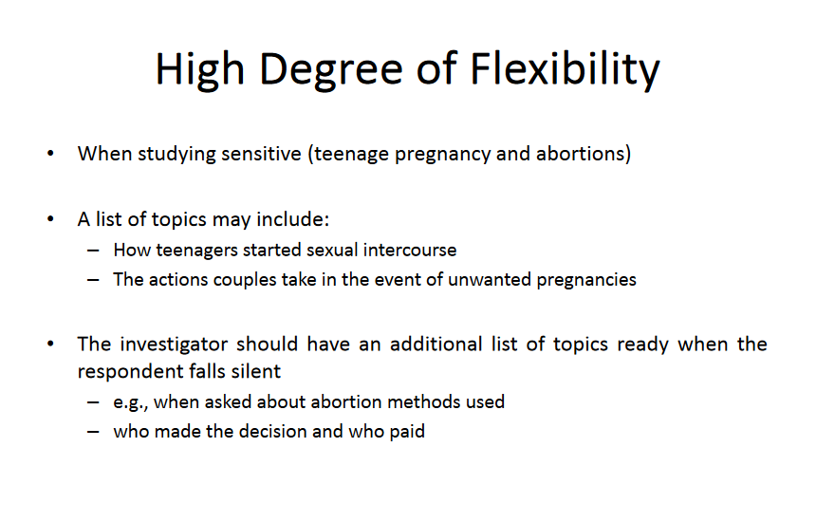

Slide 33
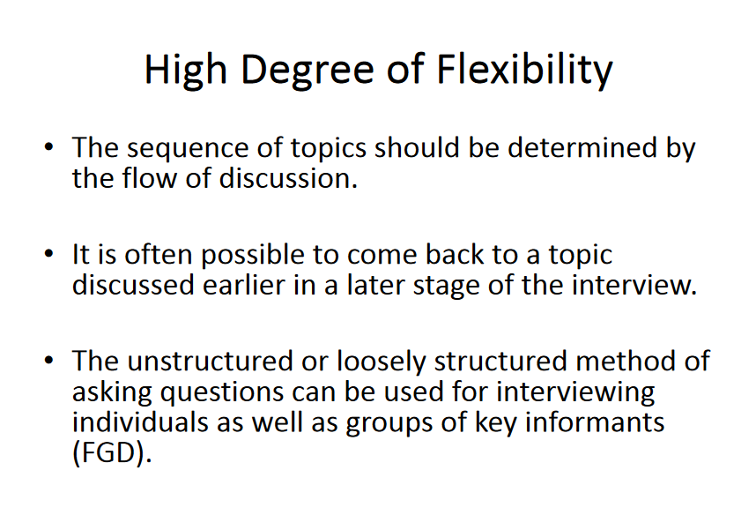

Slide 34
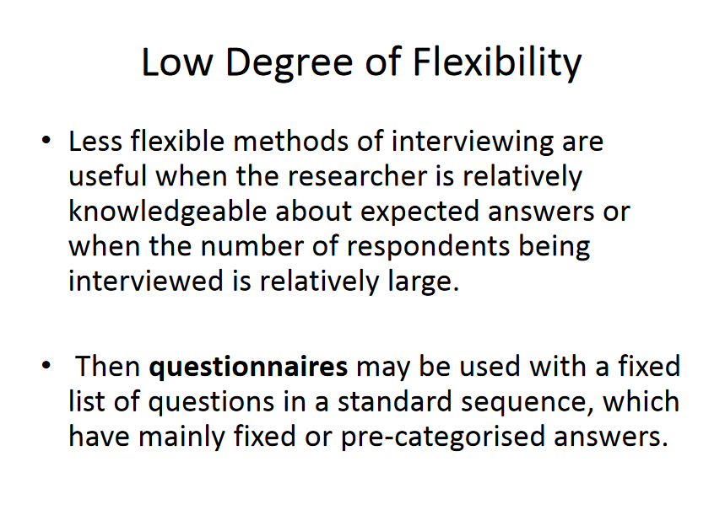

Slide 35
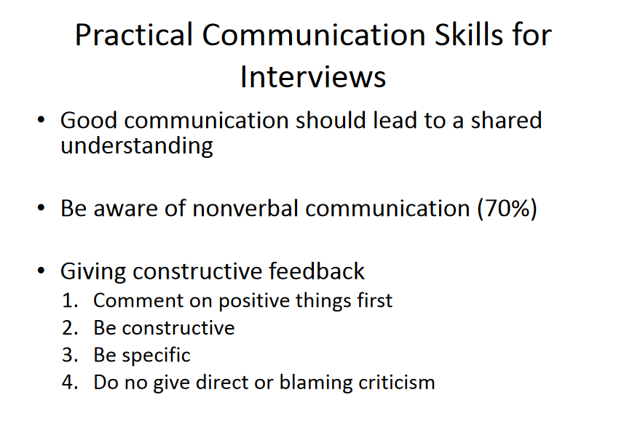

Slide 36
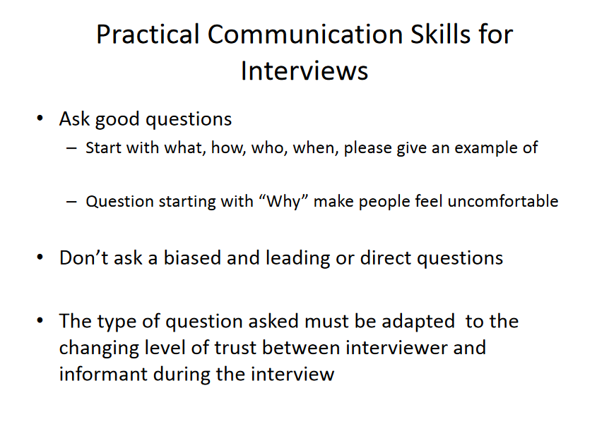

Slide 37
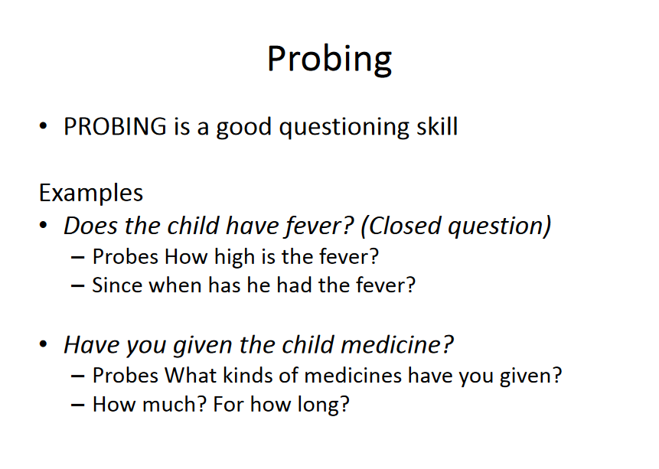

Slide 38
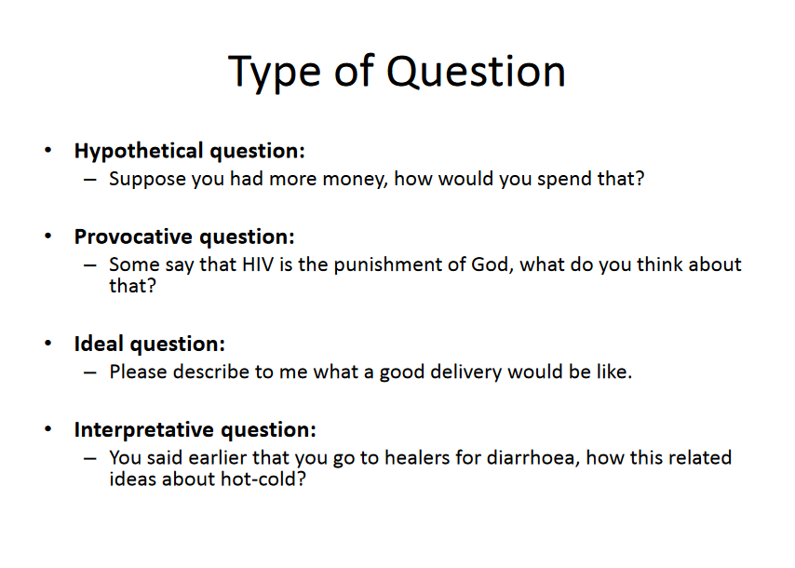

Slide 39
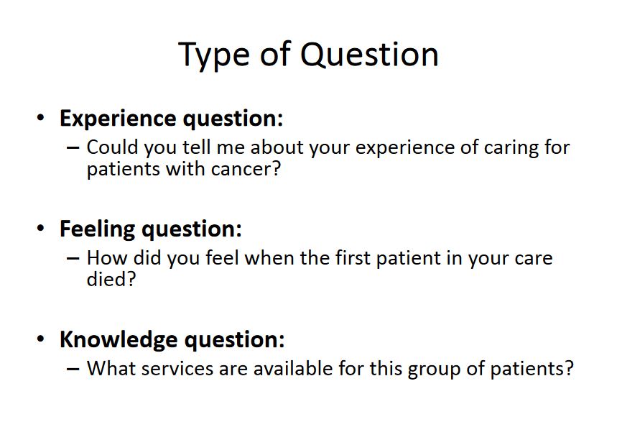

Slide 40
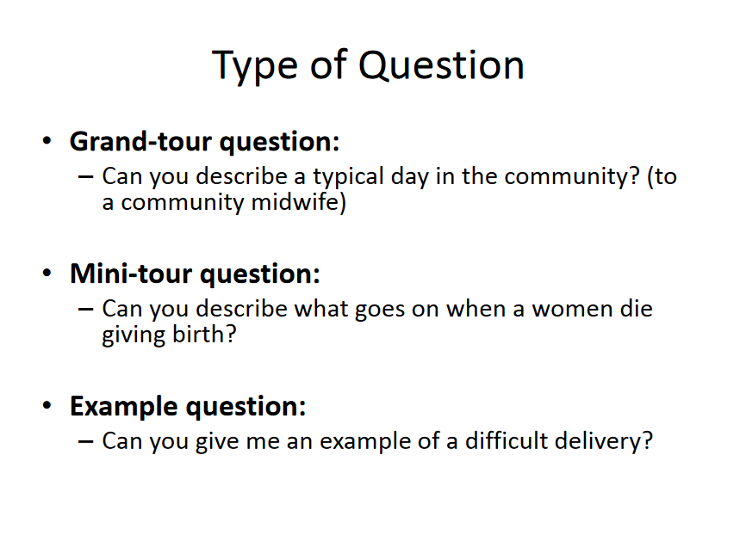

Slide 41
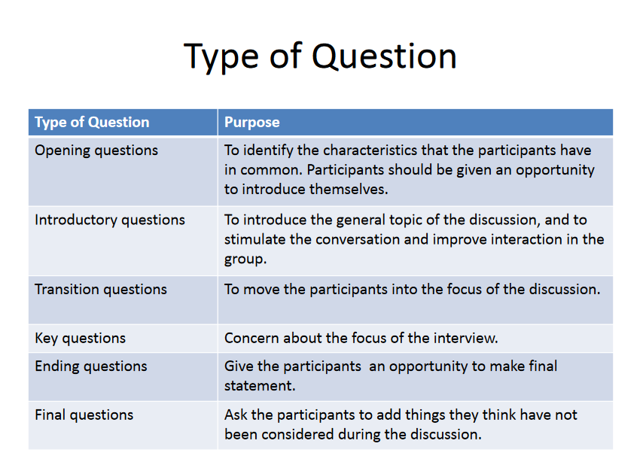

Slide 42
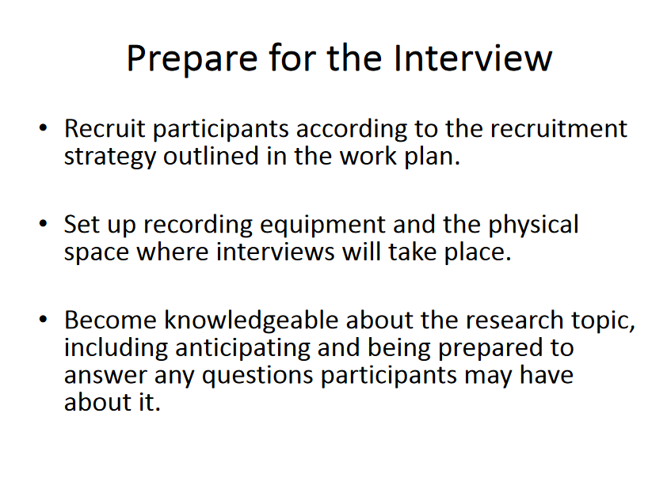

Slide 43
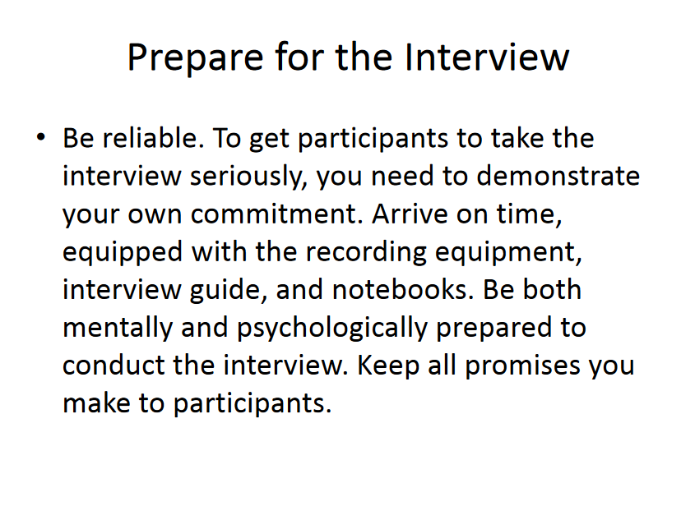

Slide 44
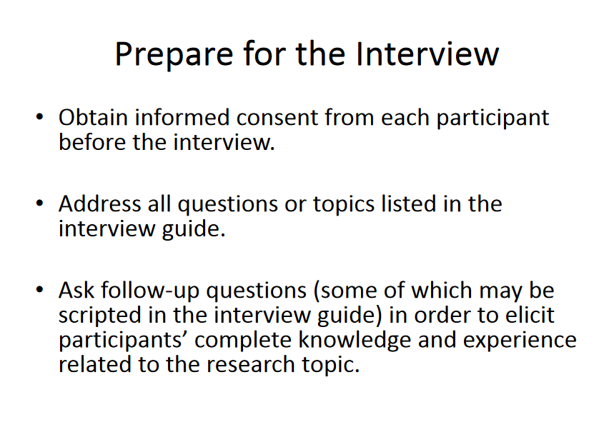

Slide 45
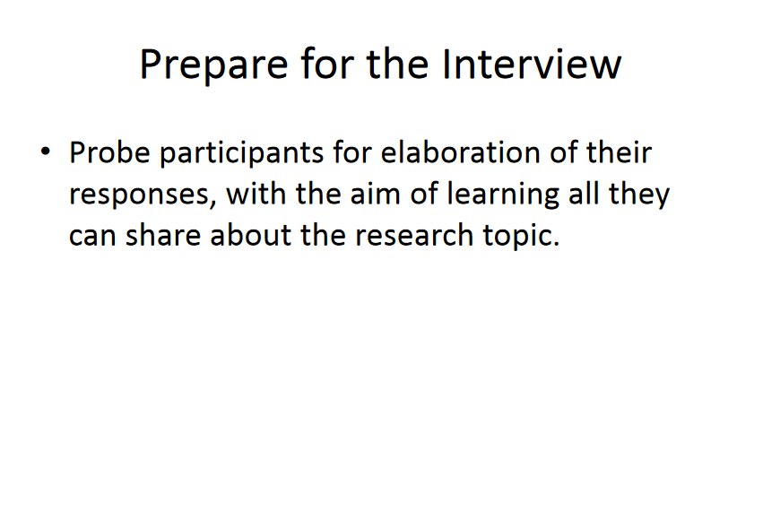

Slide 46
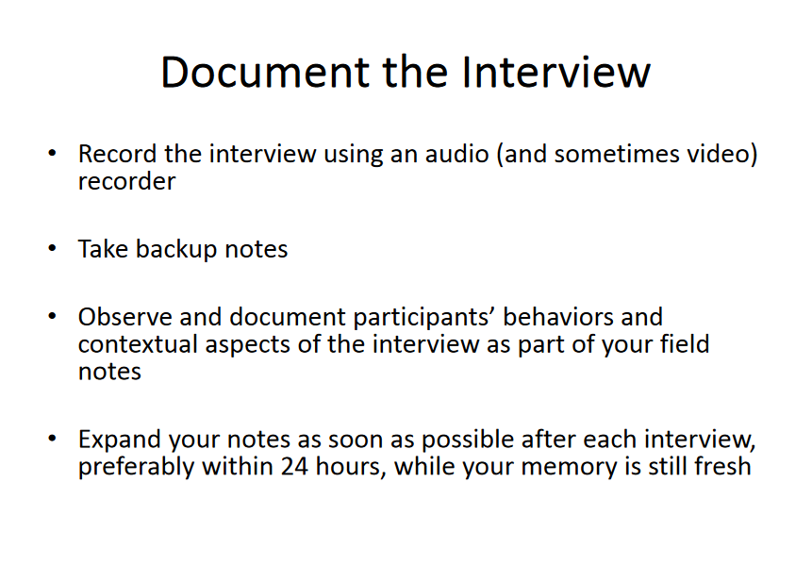

Slide 47
Pros and Cons of Three Major Techniques for Collecting Data:
Questionnaires
Interviews
Observation

Slide 48
Using these data gathering methods
Each method has advantages and problems. No single method can fully measure the variable important to OD
Examples:
  Questionnaires and surveys are open to self-report biases, such as respondents’ tendency to give socially desirable answers rather than honest opinions.
  Observations are susceptible to observer biases, such as seeing what one wants to see rather than what is actually there.

Slide 49
Use more than one
Because of the biases inherent in any data-collection method, it is best to use more than one method when collecting diagnostic data.
The data from the different methods can be compared, and if consistent, it is likely the variables are being validly measured.

Slide 50

Demographics
Information about the people you are gathering data from is important.
Collect the specific demographics necessary. Some examples
  Age
  Gender
  Income level
  Ethnic background
  Status (student, teacher, visitor)
Be careful not to collect demographics that are not specific to your data collection purpose.

Slide 51
Questionnaires:
Questionnaires are one of the most efficient ways to collect data.
They contain fixed-response questions about various features of an organization.
These on-line or paper-and pencil measures can be administered to large numbers of people simultaneously.
They can be analyzed quickly.
They can be easily be fed back to employees.
Questionnaires can be standard based on common research or they can be customized to meet the specific data gathering need.

Slide 52
Questionnaires; there are drawbacks;
Responses are limited to the questions asked in the instrument.
They provide little opportunity to probe for additional data or ask for points of clarification.
They tend to be impersonal.
Often elicit response biases – tend to answer in a socially acceptable manner.

Slide 53
Sample Employee / Management Relationship Survey
Team Goals and Objectives
Unclear; diverse; conflicting | 1 2 3 4 5 | Clear; understood; shared by all.
Role Clarity
Employees are unclear about their roles; responsibilities and authority are ambiguous. | 1 2 3 4 5 | Employees are clear about what is expected of them; they know their responsibilities and authority.
Communications
Employees are guarded and cautious when communicating with management | 1 2 3 4 5 | Employees are open and authentic when communicating with management
Decision Making
Little opportunity for input; uninvolved; decisions made autonomously. | 1 2 3 4 5 | Decisions made jointly through group participation; plenty of opportunity for input; persons affected asked for their opinion.

Slide 54
Interviews
Interviews are probably the most widely used technique for collecting data in OD.
They permit the interviewer to ask the respondent direct questions.
Further probing and clarification is possible as the interview proceeds.
This flexibility is invaluable for gaining private views and feelings about the organization and exploring new issues that emerge during the interview.

Slide 55
Interviews
Interviews may be highly structured, resembling questionnaires, or highly unstructured, starting with general questions that allow the respondent to lead the way.
Interviews are usually conducted one-to-one but can be carried out in a group.
Group interviews save time and allow people to build on other’s responses.
Group interviews may, however, inhibit respondent’s answers if trust is an issue.

Slide 56
Interviews / Focus Groups
Another unstructured group meeting conducted by a manager or a consultant.
A small group of 10-15 people is selected representing a larger group of people
Group discussion is started by asking general questions and group members are encouraged to discuss their answers in some depth.
The richness and validity of this information will depend on the extent that trust exists.

Slide 57
Drawback to interviews
They can consume a great deal of time if interviewers take full advantage of the opportunity to hear respondents out and change their questions accordingly.
Personal biases can also distort the data.
The nature of the question and the interactions between the interviewer and the respondent may discourage or encourage certain kinds of responses.
It take considerable skill to gather valid data.

Slide 58
TASK 2
Find 2 empirical articles, first in education and second in accounting
Identify the data collection method and instruments used
Provide your suggestions for making the both research better in term of data collection method and instruments used

