Slide 1
Relationships between Science and Religion

Slide 2
What is Science?
The word scientia meant general knowledge and
sapientia which meant wisdom

Slide 3
A Definition of Science
  Science is a process, not a body of knowledge
  Science is always tentative
  Science deals with empirical knowledge
  Science includes explanations in the form of hypotheses, theories, and laws

Slide 4
A Definition of Religion
A strong belief in a supernatural power or powers that control human destiny
An institution to express belief in a divine power
A belief concerning the supernatural, sacred, or divine, and the practices and institutions associated with such belief
The sum total of answers given to explain humankind’s relationship with the universe

Slide 5
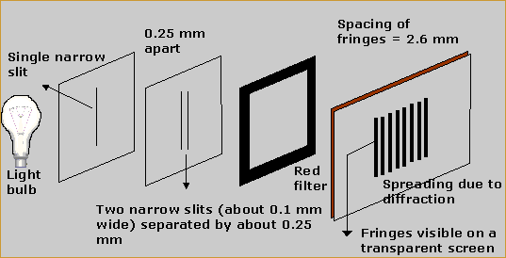
How Do We Know Things in Science?
Experiments seek to control all variables associated with a phenomenon
Observation of phenomena that can’t be controlled (cosmology) together with reason
Evidence is reported in peer-reviewed journals available to all
Best explanations are predictive

Slide 6
How Do We Know Things in Religion?
Sacred (suci) texts are inspired by divine (Tuhan) power
Individual revelation (wahyu) through visions, dreams, prayer, events
Reason about the nature of God and the relationship between God and humans
Study of sacred texts and the conditions under which they were written
Study of the natural world?

Slide 7
Scientific and Beliefs
Scientific
Beliefs
Nature can be studied by humans
Nature works by natural cause and effect
Natural phenomena are repeatable/observable
Experiments and observations are needed for explanation
Humans are made in the image of God
God rules the world in a faithful, consistent manner
God has established natural laws
Humans are not able to understand God’s world completely

Slide 8
What is Religion?
Religion is a body of beliefs and practices

Slide 9
How Do Science and Religion Relate to Each Other?
  Conflict
  Independence
  Dialogue
  Integration

Slide 10

Conflict
Religion and science are two ways of viewing the same things; therefore one is correct and the other is incorrect

Slide 11
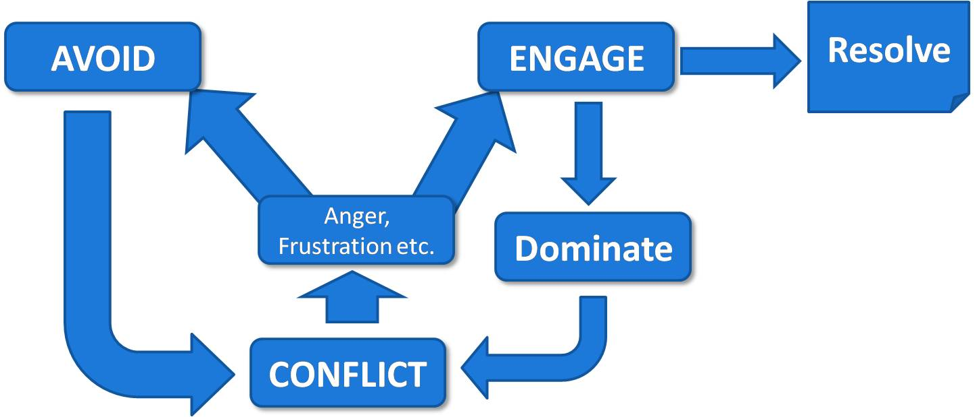
Image source: http://www.maximumadvantage.com/conflict-resolution-in-the-workplace.html (fair use)

Slide 12

Independence
Contrasting Methods
  Science and religion are separate spheres of human life
  Religious faith depends on divine initiative, science relies on human discovery
  Science is thought to be testable, public, and objective while religion is not testable, private, and subjective

Slide 13
Independence
Differing Languages
  Scientific language is used primarily for prediction and control (theories, delimited questions)
  Religious language elicits a set of attitudes and encourages allegiance to moral principles
  Religious language often deals with liberation from suffering and experiences of peace and unity (not scientific)

Slide 14

Dialogue
Methodological parallels
Religion and science are alike in certain ways: religion is not necessarily completely subjective and science is not necessarily completely objective
If God created the world and humans, God meant for humans to know the world

Slide 15
Integration
  Science and religion both contribute to an inclusive metaphysics, such as in process philosophy

Slide 16
Questions
Which of the ways of knowing are you most comfortable with?
The media tend to emphasize the conflict model. Why do you think this is so? Is this the most common model?
What is the role of reason in religion? In what ways does science seem like a religion?

