Slide 2

Create new course

Slide 3
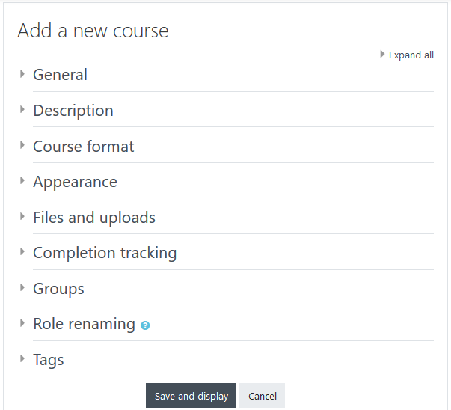

Slide 4
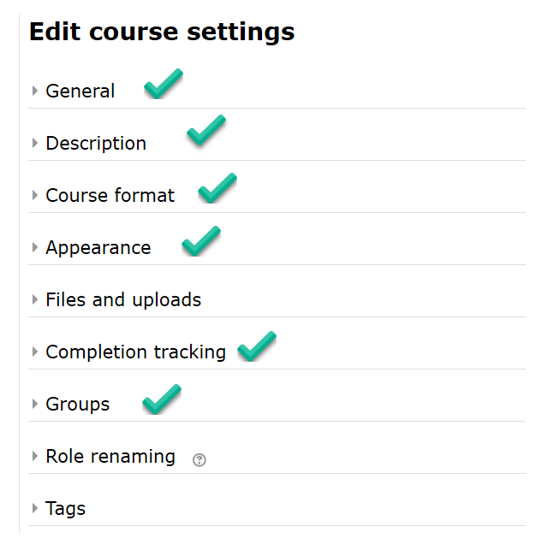
Edit Course Settings

Slide 5
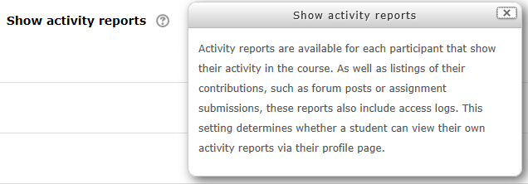
Show Activity Reports

Slide 6
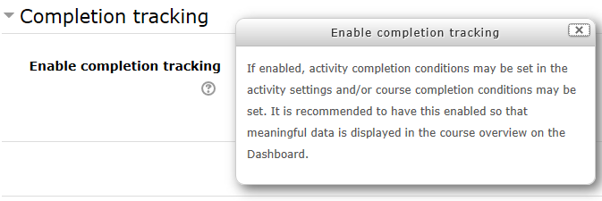
Completion Tracking

