Slide 1
Conjunctions

Slide 2
Conjunctions
Coordinating conjunctions → used to connect two independent clauses
Subordinating conjunctions → used to establish the relationship between the dependent clause and the rest of the sentence
Correlative conjunctions → used to join various sentence elements which are grammatically equal

Slide 3
Coordinating conj.
remember them, the acronym FANBOYS can be used.
F = for (untuk)
A = and (dan)
N = nor (bukan salah satu dari)
B = but (tetapi)
O = or (atau)
Y = yet (tetapi)
S = so (sehingga)

Slide 4
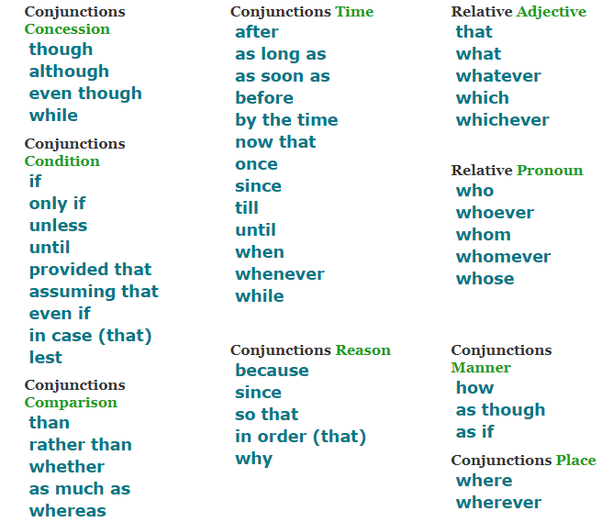
Subordinating conj.

Slide 5
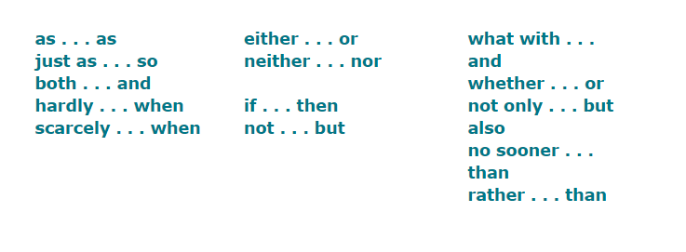
Correlative conj.

Slide 6
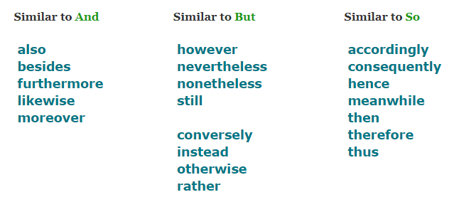
Conjunctive adverbs

Slide 7
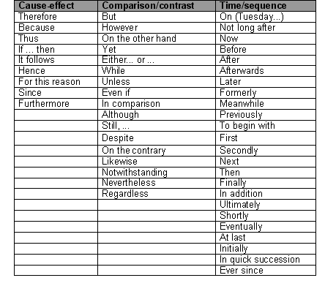

Slide 8
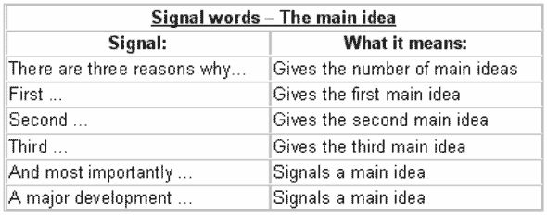

Slide 9
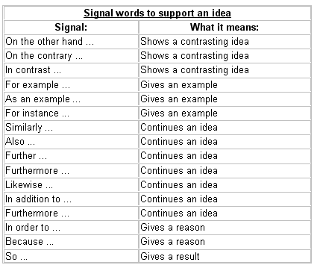

Slide 10
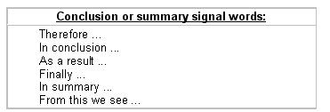

Slide 11
Assignment
Now, write a story or a cooking procedure which consists of minimum 10 sentences using conjunctions.
Write it using this template. The more creative you use conjunction, the more score you will get.
Title of story:
1. …… 2. …… 3. …… 4. …… 5. …… 6. …… 7. …… 8. …… 9. …… 10. ……

