Slide 1
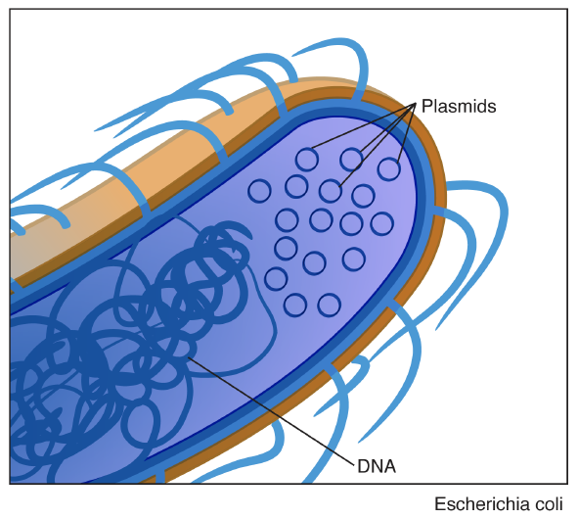
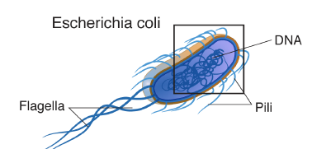
Plasmids
Small circular DNA molecules that replicate independently of the host chromosomes
Indispensable tools that allow molecular biologists to obtain essentially unlimited amounts of a DNA sequence

Slide 2
How are plasmids constructed?
What functional elements are found in our yeast overexpression plasmids?
How are plasmids purified?

Slide 3
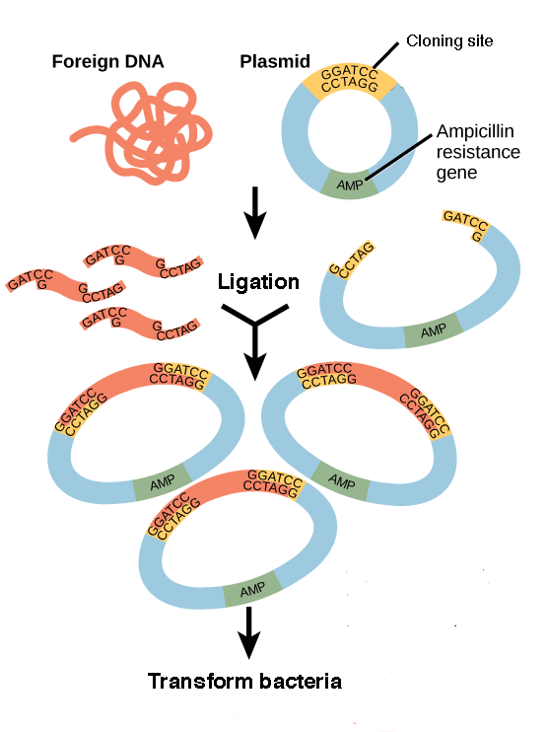
Plasmids used in molecular biology have been constructed in the lab
Molecular cloning
Enzymes are used to insert desired pieces of foreign DNA into plasmids
Bacterial cells are transformed with the plasmids. Copies of the plasmids are purified from bacteria.

Slide 4
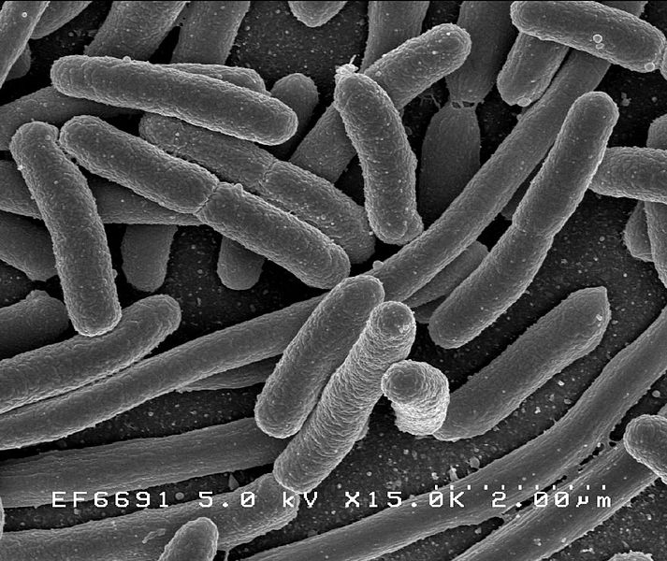
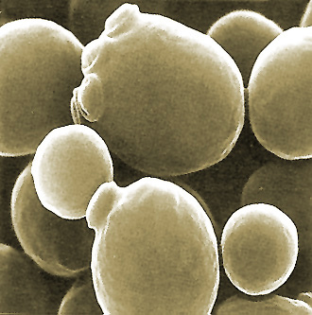
We are using plasmids that have been termed shuttle vectors, because they can be propagated in either bacteria or yeast
non-pathogenic strain of Escherichia coli
Saccharomyces cerevisiae deletion strains
Plasmids are propagated in bacteria, which grow quickly and maintain multiple copies of the plasmids
Plasmid-encoded genes are expressed in yeast, and phenotypes are analyzed
Shuttle vectors have origins of replication and selectable markers for propagation in both bacteria and yeast

Slide 5
How are plasmids constructed?
What functional elements are found in our yeast overexpression plasmids?
How are plasmids purified?

Slide 6
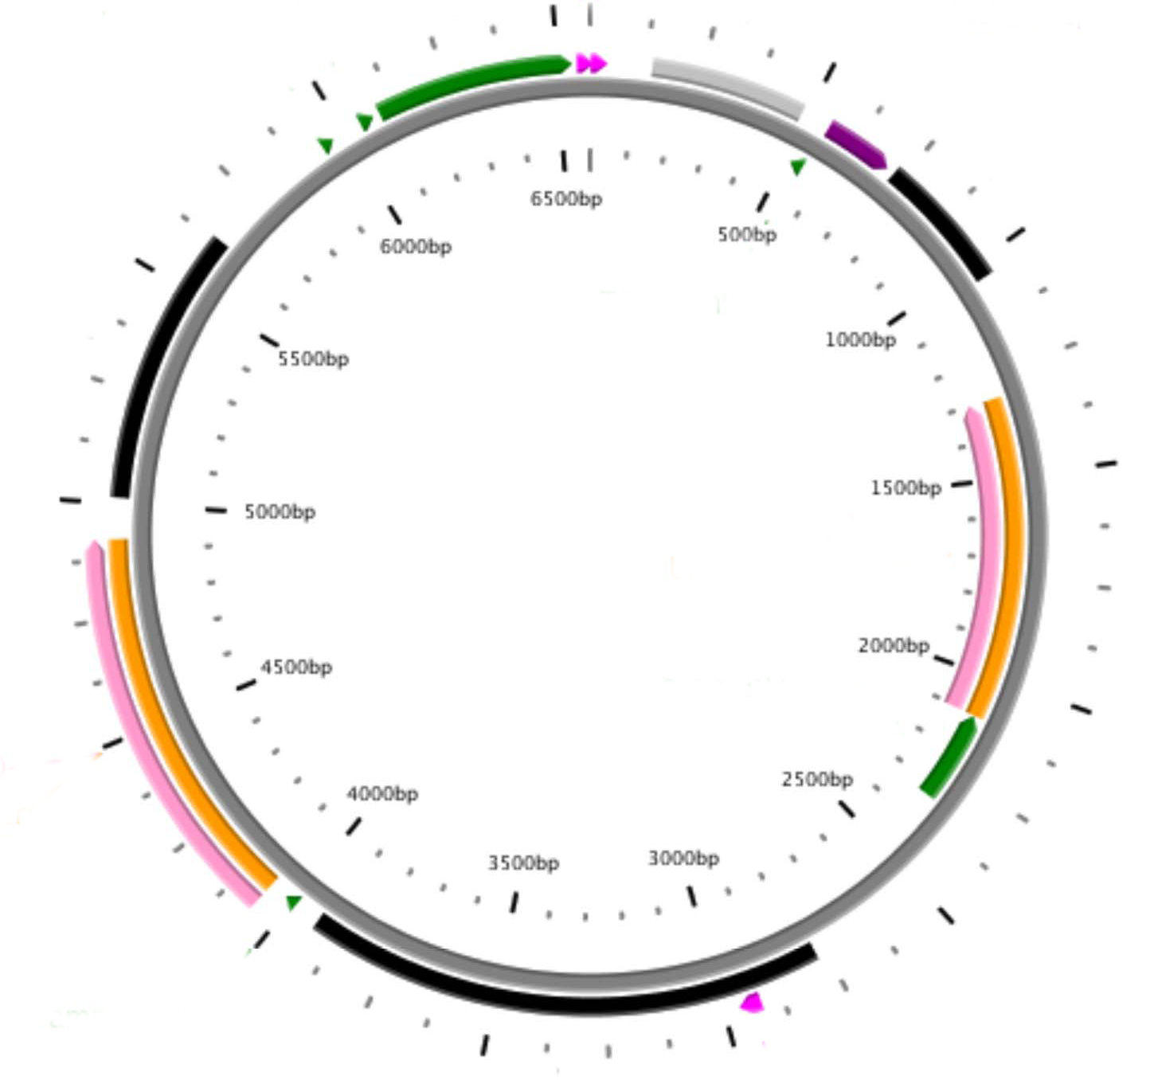
The pBG1805*-derived plasmids are complex vectors designed to express S. cerevisiae ORFs
5
6
1
URA3
2
β-lactamase gene
3
ORF goes here
3
pBR322 ori
1
2
4
yeast 2 µm origin
5
GAL1 promoter
4
6
C-terminal tags
*Plasmid names begin with a lower case “p”

Slide 7
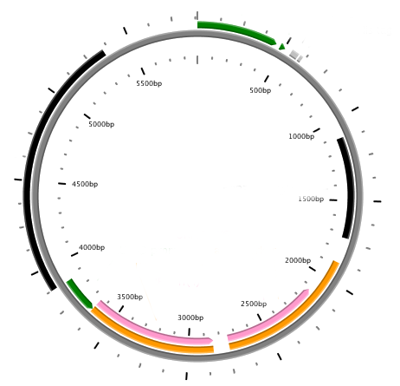
pYES2.1-based plasmids used for S. pombe ORFs have many elements in common with pBG1805-based plasmids
1
URA3
3
pBR322 ori
5
GAL1 promoter
2
β-lactamase gene
4
yeast 2 µm origin
6
7
C-terminal tags
5
6
5
7
3
4
ORF goes here
3
1
ORF goes here
2
2
1
4
pBG1805 (6573 bp)
used for S. cerevisiae ORFs
pYES2.1 (5886 bp)
used for S. pombe ORFs

Slide 8
How are plasmids constructed?
What functional elements are found in our yeast overexpression plasmids?
How are plasmids purified?

Slide 9

Plasmid purification is based on their distinctive physical properties
Plasmids are much smaller than bacterial chromosomes
Plasmids are supercoiled in their native form
Supercoiling allows plasmids to renature quickly after they are denatured
Plasmids used in molecular biology are highly engineered and contain elements of use to researchers

Slide 10
Plasmid purification from bacteria relies on their unique physical properties
MANY different, well-folded proteins
contains
contains
1-2 copies of large (>Mbp) , circular bacterial DNA complexed with proteins
Bacterial cell with plasmids
contains
Multiple copies of small (5-15 kbp) plasmids
Purification involves sequential denaturation and renaturation steps

Slide 11
Cells are first treated with base and a detergent
Proteins denature irreversibly
Chromosomal DNA denatures—will have difficulty renaturing because of its length and many proteins complexed to it
breaks open membrane and denatures both DNA and proteins
Plasmids denature, but strands stay together because of supercoiling

Slide 12
Extract is neutralized to allow DNA molecules to renature
Plasmids renature and are suspended in the SUPERNATANT
following centrifugation
Proteins and chromosomal DNA form aggregate irreversibly, forming a PRECIPITATE that can be collected by centrifugation
When purifying plasmids, use a micropipette to remove the supernatant for further processing steps

Slide 13
Zyppy purification kit use multiple steps to purify plasmids
Alkaline lysis
Neutralization
Purification of plasmid DNA on a silica resin
Elution of purified DNA from he silica resin
Let's look at the individual steps……………..

Slide 14
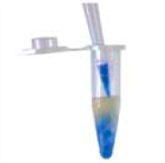
1 Transformed E. coli cultures are concentrated by centrifugation
Alkaline lysis
2. The cell pellet is resuspended in 600 µL TE buffer by vortexing
3. 100 µL of 7X Blue Zyppy lysis buffer is added
0.1 N NaOH in buffer lyses the cells
GENTLY mix the contents by inverting the tube 4-6 times
Solution changes from cloudy to clear when cells are lysed
Warning: too much mechanical agitation can shear chromosomal DNA

Slide 15
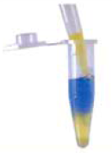
4. Add 350 µL yellow Zyppy Neutralization buffer
Mix by inverting several times
Neutralization
A heavy precipitate will begin to form immediately! The initial “glop” will become more granular when neutralization is complete—but don’t overdo it!
The precipitate contains denatured proteins and the denatured chromosomal DNA.
5. Spin down the denatured molecules for 3 minutes at top speed. CAREFULLY remove the supernatant containing the plasmid – Don't be greedy! Purity is preferred to yield!

Slide 16
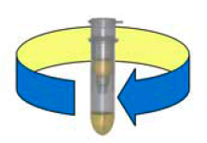
Purification on Zyppy silica resin
6. Apply the supernatant to the spin column. Place the column in the collection tube. Centrifuge the column for ~15 seconds at top speed.
7. Discard the flow through in the collection tube. Add 200 µL Zyppy EndoWash. Centrifuge ~15 sec.
8. Discard the flow through in the collection tube. Add 400 µL Column Wash. Centrifuge 1 min.
EndoWash contains guanidine hydrochloride and isopropanol. It removes contaminating proteins that are bound to the resin.

Slide 17
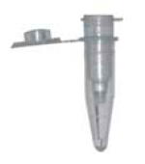
Plasmid Elution
9. Transfer the column to a clean, LABELED microcentrifuge tube
10. Add 50 µL TE buffer directly on top of the column. Allow the column to stand upright in the test tube for ~10 min. (Plasmid is being eluted.)
11. Spin the column for 30 seconds. Plasmid DNA will be collected in the microcentrifuge tube.
Pure plasmid DNA collects here!

