Slide 1
INTRODUCTION OF BIOYECHNOLOGY

Slide 2
WHAT IS BIOTECNOLOGY
The term biotechnology was coined in 1917, by Hungarian engineer, Karl erky, to describe a process for large scale production of pigs.
Biotechnology can be defined as the application of technology using the living organisms to obtain useful products
Biotechnology is the application of biological organisms systems or process to manufacturing and service industries
Biotechnology is the application of biological organisms systems or process to manufacturing and service industries ( British biotechnologists)
Biotechnology is integrated use of biochemistry, microbiology and engineering sciences in order to achieve technological applications of microbes, cultured cells and parts there of (European federation of biotechnologist)
Biotechnology is the controlled use of biological agents, such as microbes or cellular components (U.S.National science foundation)

Slide 3
Biotechnology is multidisciplinarian in nature, involving input from:
Engineering
Computer Science
Cell and Molecular Biology
Microbiology
Genetics
Physiology
Biochemistry
Immunology
Virology
Recombinant DNA Technology → Genetic manipulation of bacteria, viruses, fungi, plants and animals, often for the development of specific products
• Biostatistics
• Enzymology

Slide 4
Development of Biotechnology
Ancient Biotechnology: early history relates to food and shelter, includes domestication.
Classical Biotechnology: fermentation food production and medicine.
Modern Biotechnology: manipulates genetic information in an organism. genetic engineering.

Slide 5
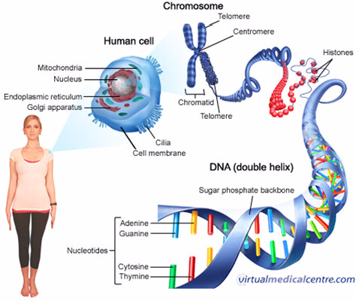

Slide 6
Modern Biotechnological processes
Genetic engineering:
It is in vitro DNA technology used to isolate genes from an organism manipulate them in laboratory as per desire and insert them into other cell or system for specific character. It is also called gene cloning.
Recombinant DNA technology is one of the recent advances in biotechnology, which was developed by two scientists named Boyer and Cohen in 1973.

Slide 7
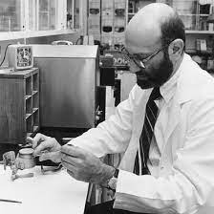
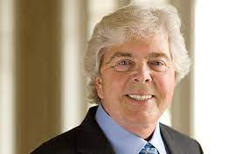
Stanley N. Cohen (1935) , who received the Nobel Prize in Medicine in 1986 for his work on discoveries of growth factors
Stanley N. Cohen (1935) , who received the Nobel Prize in Medicine in 1986 for his work on discoveries of growth factors

Slide 8
Recombinant DNA technology works by taking DNA from two different sources and combining that DNA into a single molecule. That alone, however, will not do much.
Recombinant DNA technology only becomes useful when that artificially-created DNA is reproduced. This is known as DNA cloning.
In the early 1970s, technologies for the laboratory manipulation of nucleic acids emerged. In turn, these technologies led to the construction of DNA molecules composed of nucleotide sequences taken from different sources. The products of these innovations, recombinant DNA molecules, opened exciting new avenues of investigation in molecular biology and genetics, and a new field was born— recombinant DNA technology (RDT).

Slide 9
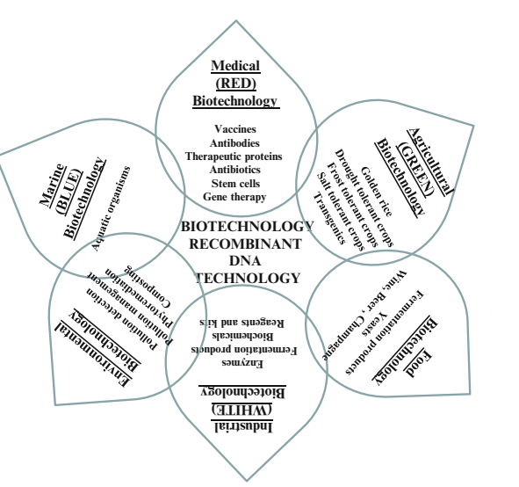

Slide 10
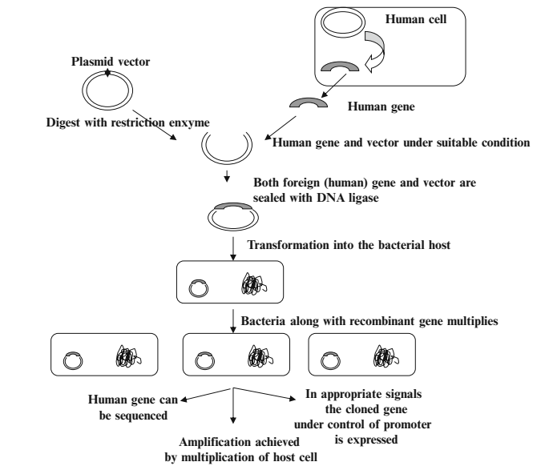

Slide 11
