Slide 1
Strategic Human Resources Management
Personal
Characteristics
Fakultas Ekonomi
Universitas Negeri Yogyakarta
2012

Slide 2
Personality
Value & Belief
Culture
Ability & Competencies
Motive

Slide 3
What is Personality?
Personality
  The sum total of ways in which an individual reacts and interacts with others; measurable traits a person exhibits.
Personality Traits
  Enduring characteristics that describe an individual’s behavior.

Slide 4
Personality Determinants
Heredity(遺傳)
Environment
Situation

Slide 5
The Myers-Briggs Type Indicator (MBTI)
A personality test that taps four characteristics and classifies people into 1 of 16 personality types.
next

Slide 6
Personality Types in MBTI
Extroverted(外向的) vs. Introverted (E or I)
Sensing vs. Intuitive (S or N)
Thinking vs. Feeling (T or F)
Judging vs. Perceiving (P or J)
binary
Score is a combination of all four (e.g., ENTJ)

Slide 7
Usage and Shortcoming for MBTI
A Meyers-Briggs score
  Can be a valuable tool for self-awareness and career guidance
BUT
  Should not be used as a selection tool because it has not been related to job performance!!!

Slide 8
The Big Five Model of Personality Dimensions
Extroversion(外向性)
Agreeableness (隨和性)
Conscientiousness(認真盡責性)
Emotional Stability(情緒穩定性)
Openness to Experience(嘗試性)
next

Slide 9
Big Five Model: Extroversion (外向性)
Sociable
Gregarious(合群的)
Assertive(獨斷的)

Slide 10
Big Five Model: Agreeableness (隨和性)
Good-natured
Cooperative
Trusting

Slide 11
Big Five Model: (認真盡責性) Conscientiousness
Responsible
Dependable
Persistent(堅持不懈的)
Organized

Slide 12
Big Five Model: (情緒穩定性)
Emotional Stability
Positive
  Calm(鎮靜的)
  Self-confident
  Secure(牢靠的) under stress
Negative
  Nervous(緊張不安的)
  Depressed(憂鬱的)
  Insecure under stress

Slide 13
Big Five Model:
Openness to Experience
Curious(好奇的)
Imaginative(有想像力的)
Artistic
Sensitive

Slide 14
Measuring Personality
Personality is Measured By
Self-report surveys
Observer-rating surveys
Projective measures
  Rorschach Inkblot Test
  Thematic Apperception Test
Notes:
Measurement Carefully cause of:
Why
Who
What
Where
When
Position
Note to personality research

Slide 15
Major Personality Attributes Influencing OB
Core Self-evaluation
  Self-esteem
  Locus of Control
Machiavellianism(權術主義/馬基維利主義)
Narcissism(自戀)
Self-monitoring
Risk taking
Type A vs. Type B personality
Proactive Personality
next

Slide 16
Core Self-Evaluation: Two Main Components
Self Esteem
  Individuals’ degree of liking or disliking themselves.
Locus of Control
  The degree to which people believe they are masters of their own fate.
  Internals (Internal locus of control)
  Individuals who believe that they control what happens to them. → everythings
  Externals (External locus of control)
  Individuals who believe that what happens to them is controlled by outside forces such as luck or chance.

Slide 17
Machiavellianism (Mach)
Degree to which an individual is pragmatic, maintains emotional distance, and believes that ends can justify means.
Some one who Machiavellianism, ability to keep and maintain their emotions

Slide 18
Conditions Favoring High Machs
Direct interaction with others
Minimal rules and regulations
Emotions distract(分散) for others

Slide 19
Narcissism
A Narcissistic Person
  Has grandiose(誇張的) sense of self-importance
  Requires excessive admiration(讚美)
  Has a sense of entitlement(應得的權利)
  Is arrogant(自負的)
  Tends to be rated as less effective

Slide 20
Self-Monitoring
A personality trait that measures an individual’s ability to adjust his or her behavior to external, situational factors.

Slide 21
High Self-Monitors
Receive better performance ratings
Likely to emerge as leaders
Show less commitment to their organizations

Slide 22
Risk Propensity
Aligning managers’ risk-taking propensity(性格上的傾向) to job requirements should be beneficial to organizations.

Slide 23
Risk-Taking
High Risk-taking Managers
  Make quicker decisions
  Use less information to make decisions
  Operate in smaller and more entrepreneurial(創業者的) organizations
Low Risk-taking Managers
  Are slower to make decisions
  Require more information before making decisions
  Exist in larger organizations with stable environments

Slide 24
Personality Types
Type A vs. Type B
next

Slide 25
Personality Types A
are always moving, walking, and eating rapidly;
feel impatient(無耐心的) with the rate at which most events take place;
strive to think or do two or more things at once;
cannot cope(妥善處理) with leisure time;
are obsessed(迷住) with numbers, measuring their success in terms of how many or how much of everything they acquire.

Slide 26
Personality Types B
never suffer from a sense of time urgency with its accompanying(伴隨) impatience(無耐心的) ;
feel no need to display or discuss either their achievements or accomplishments;
play for fun and relaxation, rather than to exhibit(顯出) their superiority(優勢) at any cost;
can relax without guilt(內疚).

Slide 27
Proactive Personality
Identifies opportunities, shows initiative, takes action, and perseveres(堅持不懈) until meaningful change occurs.
Creates positive change in the environment, regardless or even in spite(惡意對待) of constraints or obstacles(妨礙).

Slide 28
Personality and National Culture
Individualistic vs. collectivistic
  The Big Five Model appear to predict a bit better in Individualistic culture then in collectivistic
There are no common personality types for a given country.
A country’s culture influences the dominant personality characteristics of its population, like locus of control and Type A personality.

Slide 29
Values
Definition: Mode of conduct or end state is personally or socially preferable (tenure, age, gender, etc)
  i.e., what is right & good
Note: Values Vary by Cohort(同伴)

Slide 30
Value System
A hierarchy based on a ranking of an individual’s values in terms of their intensity(強度).

Slide 31
Importance of Values
Provide understanding of the attitudes, motivation, and behaviors of individuals and cultures.
Influence our perception of the world around us.
Represent interpretations of “right” and “wrong.”
Imply(暗示) that some behaviors or outcomes are preferred over others.

Slide 32
Types of Values – Rokeach Value Survey
Terminal Values
  Desirable end-states of existence; the goals that a person would like to achieve during his or her lifetime.
Instrumental Values
  Preferable modes of behavior or means of achieving one’s terminal values.

Slide 33
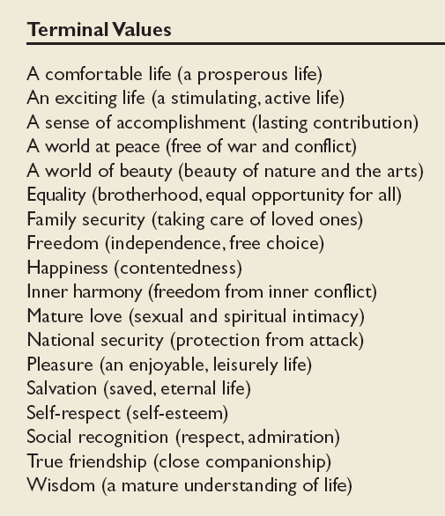
Values in the Rokeach
Survey
內心和諧
普渡眾生

Slide 34
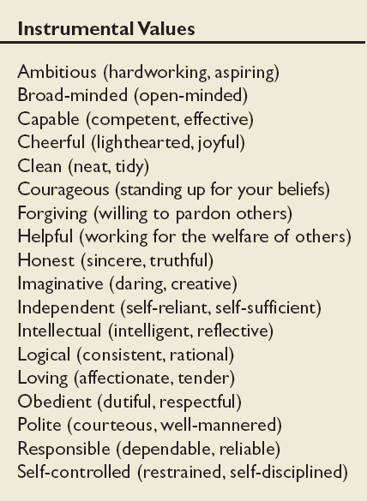
Values in the Rokeach Survey
寬恕
忠順
謙恭有禮

Slide 35
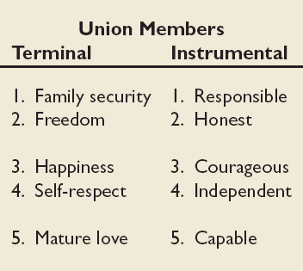
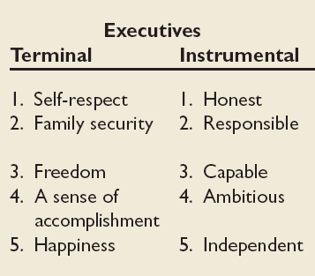
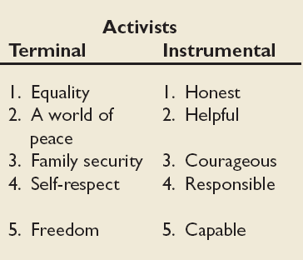
Mean Value Rankings of Executives, Union Members, and Activists
(工會)
(主管)
(社區運動)

Slide 36
Contemporary Work Cohorts
Cohort | Enter the Workforce | Approx. Current Age | Dominant Work Values
Veterans 退伍軍人 | 1950s or early 1960s | 65+ | Hardworking, conservative, conforming, loyalty to the organization
Boomers 嬰兒潮 | 1965-1985 | Early 40s to mid-60s | Success, achievement, ambition, dislike of authority, loyalty to career
Xers | 1985-2000 | Late 20s to early 40s | Work/life balance, team-oriented, dislike of rule, loyalty to relationship
Nexters | 2000 to present | Under 30 | Confident, financial success, self-reliant but team-oriented, loyalty to both self and relationship

Slide 37
Values, Loyalty, and Ethical Behavior
Ethical Climate in
the Organization
Ethical Values and Behaviors of Leaders

Slide 38
Values across Cultures: Hofstede’s Framework
Power Distance
Individualism vs. Collectivism
Masculinity(剛毅) vs. Femininity(嬌柔)
Uncertainty Avoidance
Long-term and Short-term orientation
next

Slide 39
Hofstede’s Cultures Framework: Power Distance
The extent to which a society accepts that power in institutions and organizations is distributed unequally.
Low distance: relatively equal power between those with status/wealth and those without status/wealth
High distance: extremely unequal power distribution between those with status/wealth and those without status/wealth

Slide 40
Hofstede’s Cultures Framework: Individualism vs. Collectivism
Individualism
  The degree to which people prefer to act as individuals rather than a member of groups.
Collectivism
  A tight social framework in which people expect others in groups of which they are a part to look after them and protect them.

Slide 41
Hofstede’s Cultures Framework: Masculinity vs. Femininity
Vs.
Masculinity
  The extent to which the society values work roles of achievement, power, and control, and where assertiveness and materialism are also valued.
Femininity
  The extent to which there is little differentiation between roles for men and women.

Slide 42
Hofstede’s Cultures Framework: Uncertainty Avoidance
The extent to which a society feels threatened by uncertain and ambiguous situations and tries to avoid them.
High Uncertainty Avoidance: Society does not like ambiguous situations & tries to avoid them.
Low Uncertainty Avoidance: Society does not mind ambiguous situations & embraces them.

Slide 43
Hofstede’s Cultures Framework: Long-term/Short-term orientation
Vs.
Long-term Orientation
  A national culture attribute that emphasizes the future, thrift, and persistence.
Short-term Orientation
  A national culture attribute that emphasizes the present and the here and now.

Slide 44
The GLOBLE Framework for Assessing Cultures
Assertiveness(自信)
Future orientation
Gender differentiation
Uncertainty avoidance
Power distance
Individualism/Collectivism
In-group collectivism
Performance orientation
Humane orientation

Slide 45
Achieving Person-Job Fit
Personality-Job Fit Theory (Holland)
Identifies six personality types and proposes that the fit between personality type and occupational environment determines satisfaction and turnover.
Personality Types
Realistic
Investigative
Social
Conventional
Enterprising
Artistic

Slide 46
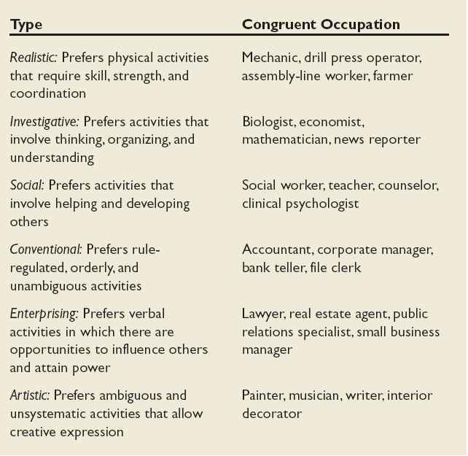
Holland’s Typology of Personality and Congruent Occupations

Slide 47
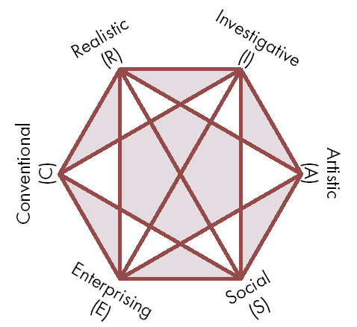
Relationships among Occupational Personality Types

Slide 48
Organizational Culture Profile (OCP)
Useful for determining person-organization fit
Survey that forces choices/rankings of one’s personal values
Helpful for identifying most important values to look for in an organization (in efforts to create a good fit)

Slide 49
Ability
Why we concern
  by knowing how people different in abilities, we may use the knowledge to increase /enhance people’s performance
What is ability
  An individual’s capacity to perform the various tasks in a job.
  Made up of two factors: Intellectual and physical
Ability
Intellectual
physical

Slide 50
Intellectual Ability
Ability
Intellectual
physical
The capacity to do mental activities—thinking, reasoning, and problem solving
Number aptitude
Verbal comprehension
Perceptual speed
Inductive reasoning
Deductive reasoning
Spatial visualization
Memory
7 Dimensions of
Intellectual Ability

Slide 51
Dimensions of Intellectual Ability
Ability
Intellectual
physical
Number Aptitude: Ability to do speedy and accurate arithmetic
Verbal Comprehension: Ability to understand what is read or heard and the relationship of words to each other.
Perceptual Speed: Ability to identify visual similarities and differences quickly and accurately.
Inductive Reasoning: Ability to identify a logical sequence in a problem and then solve the problem.
Deductive Reasoning: Ability to use logic and assess the implications of an argument.
Spatial Visualization: Ability to imagine how an object would look if its position in space were changed.
Memory: Ability to retain and recall past experiences.

Slide 52
Intelligence is one of the predictors
Ability
Intellectual
physical
intelligence is one of the predictors of job performance.
Use IQ test as hiring tools
Correlation between intelligence and Job satisfaction is about zero

Slide 53
Multiple intelligences
Ability
Intellectual
physical
Intelligences contains four subparts: cognitive, social, emotional, cultural
  Cognitive: traditional intelligence test.
  Social: ability to relate effectively to others
  Emotional: ability to identify, understand, and manage emotions.
  Cultural: awareness of cross-culture differences and the ability to function successfully in cross-cultural situation.

Slide 54
Physical Ability
Ability
Intellectual
physical
The capacity to do tasks demanding stamina, dexterity (swiftness or precision), strength, and similar characteristics.
Flexibility Factors
Extent flexibility
Dynamic flexibility
Strength Factors
Dynamic strength
Trunk strength
Static strength
Explosive strength
Other Factors
Body coordination
Balance
Stamina

Slide 55
The Ability-Job Fit
Ability-Job
Fit
Employee’s
Abilities
Job’s Ability
Requirements
Low
High
Performance
inadequate
High
Low
Organizational Inefficiencies
Reduce Job satisfaction

Slide 56
Biographical Characteristics--Age
Personal characteristics—such as age, gender, race, length of tenure—that are objective and easily obtained from personal records.
Age—performance relationship is important | performance declines with increasing age The workforce is aging Outlaw mandatory retirement of US
Age—turnover | the older one get, the less likely to quit one’s job Fewer job opportunities Long tenure :higher wage rate, longer paid vacation, better pension benefits.
Age—absenteeism | Lower avoidable absence Higher unavoidable absence
Age-- productivity | Employee over 50 were more productivity Unrelated
Age--satisfaction | The finding is mixed. Professional—increase. Non-professional—U shape

Slide 57
Biographical Characteristics--Gender
Will the differences between man and women affect their job performance?
 | difference | No difference
Productivity |  | ◎
Work schedule | ◎ when employee has pre-school children
Turnover |  | ◎
Absence | ◎ woman--higher

Slide 58
Biographical Characteristics--Race
Individuals tend to favor colleagues of their own race in performance evaluation, promotion decisions, and pay raises.
African Americans approve affirmative action to a greater degree than White
The issue of racial differences in cognitive ability test---is still on debate

Slide 59
Biographical Characteristics--Tenure
Seniority negatively related to absence.
Seniority negatively related to turnover.
Tenure on one’s previous job is a powerful predictor of the one’s future turnover.
Tenure positively related to satisfaction.

Slide 60
Learning & Theories of learning
Definition of learning
  Any relatively permanent change in behavior that occurs as a result of experience.
Theories of learning
Classical Conditioning: 1990s by Ivan Pavlov
  A type of conditioning in which an individual responds to some stimulus that would not ordinarily produce such a response.
Key Concepts
saliva
conditioned stimulus
Unconditioned stimulus
Happy

Slide 61
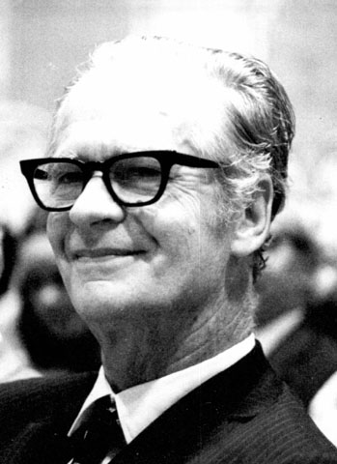
Theories of learning
Operant conditioning
  by psychologist B.F. Skinner (behaviorism)
  A type conditioning in which desired voluntary behavior leads to a reward or prevents a punishment.
  better explain voluntary behaviors
Key Concepts
People will most likely engage in desired behavior if they are positively reinforced for doing so
Rewards are most effective if they immediately follow the desired response

Slide 62
Theories of learning
Social learning
  The view that people can learn through observation and direct experience
Key Concepts
The influence of model
Four processes
  Attentional processes
  Retention processes
  Motor reproduction process
  Reinforcement processes

Slide 63
Shaping Behavior: A Managerial Tool
Shaping Behavior:
Systematically reinforcing each successive step that moves an individual closer to desired response.
Four Methods
Positive reinforcement: Following a response with something pleasant
Negative reinforcement: Following a response by the termination or withdrawal of something unpleasant
Punishment: Causing unpleasant condition in an attempt to eliminate an undesirable behavior
Extinction: Eliminating any reinforcement that is maintaining a behavior

Slide 64
Schedules of Reinforcement
Reinforcement Schedule: Continuous
  For newly emitted, unstable, or low-frequency response
Nature of Reinforcement | Effect on Behavior | Example
Reward given after each desired behavior | Fact learning of new behavior but rapid extinction | Compliments

Slide 65
Schedules of Reinforcement
Intermittent:
  Reinforcing a desired behavior often enough to make the behavior worth repeating but not every time it is demonstrated.
  ratio or interval type
  For stable or high-frequency response
Reinforcement schedule | Nature of Reinforcement | Effect on Behavior | Example
Fixed-interval | Reward given at fixed time intervals | Average & irregular performance with rapid extinction | Weekly paychecks
Variable-interval | Reward given at variable time intervals | Moderately high and stable performance with slow extinction | Pop quizzes
Fixed ratio | Reward given at fixed amounts of outputs | high and stable performance attained quickly but also with rapid extinction | Piece-rate pay
Variable-ratio | Reward given at variable amounts of outputs | Very high performance with slow extinction | Commissioned sales
Notes:
In Fixed-interval schedule, Rewards are given for time span, not for specific response. So Such schedule does not clearly link performance and rewards。
Usually, variable schedule tends to lead to higher performance than fixed schdule.

Slide 66
Behavior Modification
OB Mod
The application of reinforcement concepts to individuals in the work setting
Problem-solving Model
Identify critical behaviors
Develop baseline data
Identify behavioral consequences
Apply intervention
Evaluate performance improvement

Slide 67
Problems with OB Mod and Reinforcement Theory
OB Mod has been used by a number of org. to improve productivity, to reduce errors, absenteeism…and so on.
Problem with behaviorism
  Assume that people’s inner-most thoughts and feelings in response to the environment are irrelevant.
  research showing that thoughts and feelings immediately follow environmental stimuli
Other approach— cognitive process

Slide 68
Summary & Implications
Three individual variables
  Ability: intellectual & physical
    An effective selection process will improve the fit
    Promotion and transfer decisions should reflect the abilities of candidates
    The fit can be improved by fine-tuning the job to better match an incumbent’s abilities.
  Biographical Characteristics: age, race, gender…
    Readily observable
    Doesn’t mean should be explicitly used in management decision
  Learning
    Positive reinforcement is a powerful tool for modifying behavior
    Reinforcement is a more effective tool than punishment

Slide 69
Motivation Definition
Processes that account for an individual’s intensity, direction and persistence of effort toward attaining a goal.
  Intensity: concern with how hard a person tries
  Direction: channeled effort to Organization benefit
  Persistence: measurement of how long a person can maintain effort
Outline the motivation concept
Notes:
As describe in the book…motivation can be define as…….
Here are three elements as the keys to understand it more….
1st. Intensity that is concern with how hard a person tries
2nd Direction: channeled effort to Organization benefit
3rd Persistence: measurement of how long a person can maintain effort
Are there any additional explanations, prof. chen?

Slide 70
Motivational theories
Needs – goal setting – reinforcement – equity/organizational justice - expectancy
Classic
Hierarchy of need & ERG
Theory X and theory Y
Two factor theory
Contemporary
McClelland’s Theory of Needs
Cognitive evaluation theory
Goal setting theory
MBO Program
Self efficacy theory
Reinforcement theory
Equity theory
Expectancy theory
Notes:
There are a lot of theories as a classics theories and contemporaries ones.
The Classic theories are:
Hierarchy of need & ERG, by Abraham maslow’s the famous one and by Clayton Elderfer
Theory X and theory Y by Douglas Mc Gregor
Two factor theory by Frederick Hezberg
Contemporary theories are:
McClelland’s Theory of Needs by David McClelland
Cognitive evaluation theory by
Goal setting theory by Edwin Locke
MBO Program by
Self efficacy theory by Albert Bandura
Reinforcement theory by
Equity theory by J. Stacy Adams
Expectancy theory by Victor Vroom

Slide 71
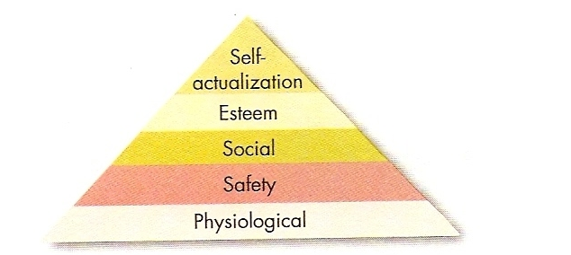
Hierarchy of need
A hierarchy of five needs, physiological, safety, social, esteem, and self actualization – exists such that as each need is substantially satisfied, the next need become dominant
Maslow’s
hierarchy
Describe Maslow’s need hierarchy
Notes:
Maslow hypothesized that within every human being exists hierarchy of five needs that describe from lower order needs to higher order needs, are:
Physiological included hunger, thirst, shelter sex, and other bodily needs
Safety include security and protection from physical and emotion harm
Social include affection, belongingness acceptances, and friendship
Esteem include internal esteem factor such as self respect, autonomy, and achievement. And external esteem factor such as status, recognition, and attention
self actualization the drive to become what on is capable of becoming, includes growth, achieving one’s potential, and self fulfillment
He said that, If one want to motivate anyone else we need to understand what level of the hierarchy that person is currently on and focus on satisfying the need at or above that level
This concept has received in wide application recognition among practicing managers. But Clayton Alderfer said that maslow’s concept failured in any study describe an inadequate conceptualization which is not readily facilitate the development of operation indicators and the initial of maslow’s theory which was not specifically aimed toward organizational setting.

Slide 72
Hierarchy of need
ERG
Self
Actualization
physiological
Safety
Social
Esteem
}
Growth
Relatedness
}
existence
Notes:
Alderfer base on his research show that Maslow hierarchy compare to ERG, for examples, the scale for assessing the maslow construct other than self actualization did not emerge with consistent clarity un any of studies. Effort to measure ‘lower order needs showed no regular pattern of reliability or validity.
He attempted to rework Maslow’s need hierarchy to align it more closely with empirical research, he propose ERG Concept that grouping Maslow need into Core Need:
Existence (similiar to maslow’s Physiological and safety need). Existence need include all of the various physiological and material desire; for example, the classic drives of hunger and thirst as wel as other material needs like work related pay, fringe benefit, and physical safety. It also characterized first by the goal of obtaining am aterial substance and second b a person’s frustration tending to be correlated with another person frustrations, when resources are limited.
Relatedness (similiar to maslow’s Social and status needs). Relatedness can characterized by mutual sharing of thought and feeling. The basic quality of relatedness needs is different from existence needs because it cannot be satisfied without mutuality.
Growth (similiar to maslow’s esteem needs and self actualization). Growth needs include desire of a person to have creative and productive effects upon him self and upon his environment.
Alderfer also assumed that there is no rigid hierarchy as in Maslow’s, person can be on a growth needs even though existence or relatedness are not satisfied yet

Slide 73
Theory X and Theory Y
Douglas McGregor
X Theory (negative views of Human being)
→ the assumption that employees dislike work, are lazy, dislike responsibilities, and must be coerced to perform
Y Theory (positive views of Human being)
→ the assumption that employees like work, are creative, seek responsibilities, and can exercise self-direction
Notes:
Other than maslow and alderfer, Douglas McGregor proposed view of human being distinctly label theory X basically tend to negative view of human being such as the assumption that employees dislike work, are lazy, dislike responsibilities, and must be coerced to perform
and theory Y that basically positive view one such as the assumption that employees like work, are creative, seek responsibilities, and can exercise self-direction
They are four assumption under theory X that held by managers as Lower order need dominate individuals, and four positive assumption under theory Y as higher order need dominate individuals.
Unfortunately, there is no evidences to confirm that either set of assumptions is valid or the accepting theory Y assumption and altering one actions accordingly with lead to more motivator workers, and Empirical support is lacking for theory X and theory Y
.

Slide 74
Two Factory theory – Motivation Hygiene theory
A theory that relates intrinsic factors to job satisfaction, while associating extrinsic factor with dissatisfaction by Frederick Herzberg
Hygiene factor: factors such as company policy and administration, supervision and salary – that when adequate in a job, placate worker. When these factor inadequate people will not be satisfied.
Hygiene factor character: condition surrounding the job such as quality of supervision, pay, company policies, physical working conditions, relation with others, and job security.
Felt Good or bad to the job categories
  Felt Good: attributed by intrinsic factors (achievement, recognition, responsibility, advancement) → related to job satisfaction
  Felt bad: cited by extrinsic factors (company policy, supervision, pay, working conditions) → dissatisfaction
Motivate people: emphasizing factors associated with the work is self or to outcomes directly derived from it (promotion opportunities, growth opportunities achievement, recognition, responsibility)
Differentiate motivators from hygiene factors
Notes:
In the belief that an individual’s relation to work is basic and that one’s attitude toward work can very well determine success or failure, Frederick Hezberg propose two factor theory called motivation hygiene theory.
Hygiene factor: factors such as company policy and administration, supervision and salary – that when adequate in a job, placate worker. When these factor inadequate people will not be satisfied.
He also assume that job categories that felt Good or bad are:
Felt Good: attributed by intrinsic factors (achievement, recognition, responsibility, advancement) → related to job satisfaction
Felt bad: cited by extrinsic factors (company policy, supervision, pay, working conditions) → dissatisfaction

Slide 75
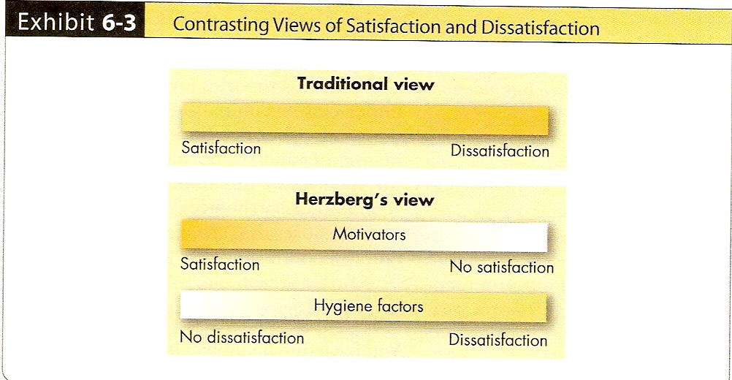
Two Factory theory – Motivation Hygiene theory
A theory that relates intrinsic factors to job satisfaction, while associating extrinsic factor with dissatisfaction
Opposite of satisfaction is not dissatisfaction (as was traditionally believed)
  Motivators: satisfaction to no satisfaction
  Hygiene :no dissatisfaction to dissatisfaction
Differentiate motivators from hygiene factors
Notes:
And Opposite of satisfaction is not dissatisfaction (as was traditionally believed)
Motivators: satisfaction to no satisfaction
Hygiene :no dissatisfaction to dissatisfaction
Finding in the application, Edmun S. boe, Management Advisory Service director 1970, said that deserve attention of anyone concern about the future of American business and few managers unfamiliar with herzberg’s recommendations
There were any criticism of this concept include The procedure limited by its methodology, Reliability is questioned
No overall measure of satisfaction utilized, Inconsistent with previous research, and Assume and methodology is not relevant.

Slide 76

Hierarchy of need: A hierarchy of five needs, physiological, safety, social, esteem, and self actualization – exists such that as each need is substantially satisfied, the next need become dominant
ERG Need:Existence, Relatedness, and Growth
X Theory (negative views of Human being) and Y Theory (positive views of Human being)
Two Factory theory – Motivation Hygiene theory
A theory that relates intrinsic factors to job satisfaction, while associating extrinsic factor with dissatisfaction
Notes:
Ok. Before we move to the next point of motivation theory. We’ll ask you for pay attention for a minutes.
What happened on this story….
What make all the runner stop and then help one of their competitor….
Are there any motivation inside?
Ok, lets continue…just keep inside your heart….

Slide 77
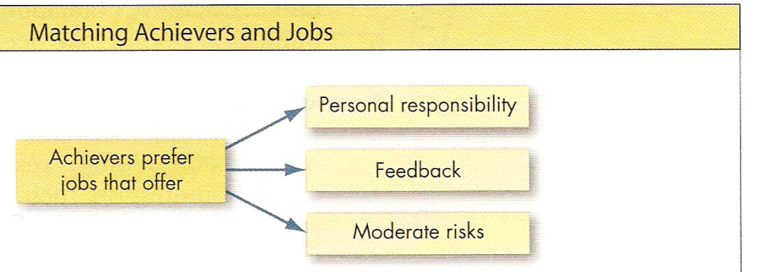
McClelland needs theory
A theory stating that achievement, power, and affiliation are three important needs that help explain motivation
Focused of need: achievement, power and affiliation
 | Description | Behavior (high)
achievement | The drive to excel, to achieve in relation to set of standards, to strive to success | Desire to do things better Attain personal responsibility for finding solutions or problems can received their rapid performance feedback Prefer task of intermediate difficulty (moderate risk) Like setting goal that required stretching them self ➔successful in entrepreneurial activities (own business or unit in large organization)
Power | The need to make others behave in a way that they would no have behave otherwise | Enjoy being “in charge” Strive influence over others Placed into competitive and status-oriented situation More concerned with prestige, and gaining influence over others than with effective performance ➔ Related to manager success (effectiveness)
Affiliation | The desire for friendly and close interpersonal relationship | Strive for friendship Prefer cooperative situation than competitive one Desire relationship that involve a high degree of mutual understanding ➔ Related to manager success
List the characteristics that high achievers prefer in a job
Notes:
McClelland state on his theory that that achievement, power, and affiliation are three important needs that help explain motivation
Achievement, drive to excel, to achieve in relation to set of standards, to strive to success. It showed in high behavior such as…
Power, needed to make others behave in a way that they would no have behave otherwise . It showed in high behavior such as…
Affiliation, the desire for friendly and close interpersonal relationship . It showed in high behavior such as…
On the application this concept, appropriate for present historical period (Lorenz J Finison) and Significant in the aggregate production function (Katherine Freeman)
And critics for this concept are Crossing the conventional boundaries of the social science disciplines is a salutary practice. If economists are to take McClelland's hypothesis seriously, however, it must have sturdier and more objective support than McClelland has managed to provide. Said SAYRE P. SCHATZ

Slide 78
Cognitive evaluation theory
A theory stating that allocating extrinsic rewards for behavior that had been previously intrinsically rewarding tends to decrease the overall level motivation
Why? Individual experiences loss of control over his or her own behavior, so that the previous intrinsic motivation diminishes.
Elimination extrinsic rewards can produce a shift perception of why some one of doing a task (focusing someone to verbal rewards than the task)
Recent theory → self concordance : the degree to which a person’s reasons for pursuing a goal is consistence with the person’s interests and core values.
  Pursued goal as an intrinsic reason more satisfied
  Pursued goal as an extrinsic reason less happy or meaningful
Notes:
Cognitive evaluation theory
Historically motivation theorist assumed that intrinsic motivators were independent of extrinsic ones but this theory state that allocating extrinsic rewards for behavior that had been previously intrinsically rewarding tends to decrease the overall level motivation.
Why? Because the Individual experiences loss of control over his or her own behavior, so that the previous intrinsic motivation diminishes.
Elimination extrinsic rewards can produce a shift perception of why some one of doing a task (focusing someone to verbal rewards than the task)
Recent theory of Cognitive evaluation theory is Self concordance are the degree to which a person’s reasons for pursuing a goal is consistence with the person’s interests and core values. Pursued goal as an intrinsic reason more satisfied and Pursued goal as an extrinsic reason less happy or meaningful

Slide 79
Goal Setting theory
A theory stating that specified and difficult goal, with feedback, lead to higher performance
Goals tell/guide what needs to be done and how much effort will need to be expended
With Difficult Goals
  direct attention (focus) to the task at hand and away from irrelevant distraction
  energize to work harder
  persist in trying to attain them
  lead to discover strategies performing task (more) effectively
With feedback
  People will do better
Performance (-goal relation factor)
  Goal commitment (believe can achieve and want to achieve)
  Task characteristics (simple, well-learned, and independent)
  National culture
Summarize the type of goals that increase performance
Notes:
Edwin Locke in the late 1960’s proposed that intentions to work to ward goal are a major of work motivation. Because the Goals tell/guide what needs to be done and how much effort will need to be expended.
With Difficult Goals
direct attention (focus) to the task at hand and away from irrelevant distraction
energize to work harder
persist in trying to attain them
lead to discover strategies performing task (more) effectively
With feedback
People will do better
Performance (-goal relation factor) influenced
Goal commitment (behaviorally an individual believe can achieve and want to achieve)
Task characteristics (the goal have more substantial effect when the task are simple rather than complex, well-learned rather than novel, and independent rather than interdependent)
National culture (this theory well adapted to country like US and Canada, because it’s key components align reasonably well with north American culture.

Slide 80
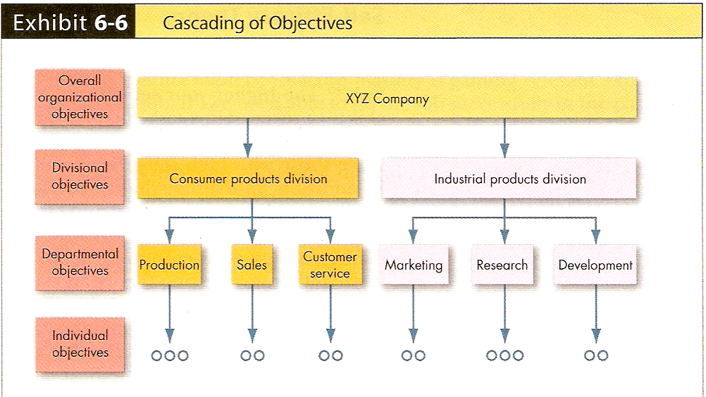
MBO
A program that encompasses specific goals, participatively sets, for an explicit time period, with feedback on goal progress
Participatively set goal by cascading the objective (organizational level, division, department and individual level)
Notes:
Installing an MBO is the answer of how do make a goal setting operationally. It was a program that encompasses specific goals, participatively sets, for an explicit time period, with feedback on goal progress.
It translate and cascade the organization objectives to the individual level. MBO provides specific personal performance objectives.

Slide 81
MBO
A program that encompasses specific goals, participatively sets, for an explicit time period, with feedback on goal progress
MBO Program ingredients
  Goal specificity
  Decision making participation
  Explicit time period
  Performance Feedback
MBO doesn’t
  Unrealistic expectation
  Top Manager’s Commitment lack
  Reward allocation Inability or unwillingness
  Cultural incompatibilities (example in Fujitsu Japan)
Notes:
There are four ingredients common to MBO Program
Goal specificity
Decision making participation
Explicit time period
Performance Feedback
Or also we know about SMART of goal (specific, Measurable, Achievable, Realistic and Time frame)
Although MBO applied in many company distribute in many countries, MBO may not work because of
Unrealistic expectation
Top Manager’s Commitment lack
Reward allocation Inability or unwillingness
Cultural incompatibilities (example in Fujitsu Japan. Management found it didn’t fit well with the Japanese culture’s emphasis on minimizing risk and emphasizing long term goals)

Slide 82
Self Efficacy theory the individual’s belief that he or she is capable of performing task (by Albert Bandura)
High Level self efficacy: more confidence, try harder to master the challenge, seem to respond to negative feedback with increased effort and motivation
Low level self efficacy: more likely to lessen effort when given negative feedback or give up altogether
Increasing Self Efficacy
  Enactive mastery (gaining relevant experience with the task or job)
  Vicarious modeling (seeing similar)
  Verbal persuasion (someone convince of skill we have successfully the task)
  Arousal (energized state drive person complete the task)
  + intelligent, conscientiousness, stable emotionally
Discuss way self-efficacy can be increase
Notes:
Arousal; pesta besar sampe mabuk (exploding balon by blowing it)
If some one ask you “hi, look at the three, my cat is over there. Its so high, I’ll take my cat but I can’t. Can you do it for me”
If your answer “ no problem, I can do it”
It mean you have high level of self efficacy. High Level self efficacy: more confidence, try harder to master the challenge, seem to respond to negative feedback with increased effort and motivation But Low level self efficacy: more likely to lessen effort when given negative feedback or give up altogether
To Increasing Self Efficacy, Albert bandura argues that there are four ways, are:
Enactive mastery (gaining relevant experience with the task or job, “if I could do that I’ll be able to do that again”)
Vicarious modeling (seeing similar, “she could pass the exams, I can do it”)
Verbal persuasion (someone convince of skill we have successfully the task, “You can do that”)
Arousal (energized state drive person complete the task, but careful in un relevant task)
A lot of research show that intelligent and personality especially intelligent, conscientiousness, stable emotionally can increase self efficacy

Slide 83
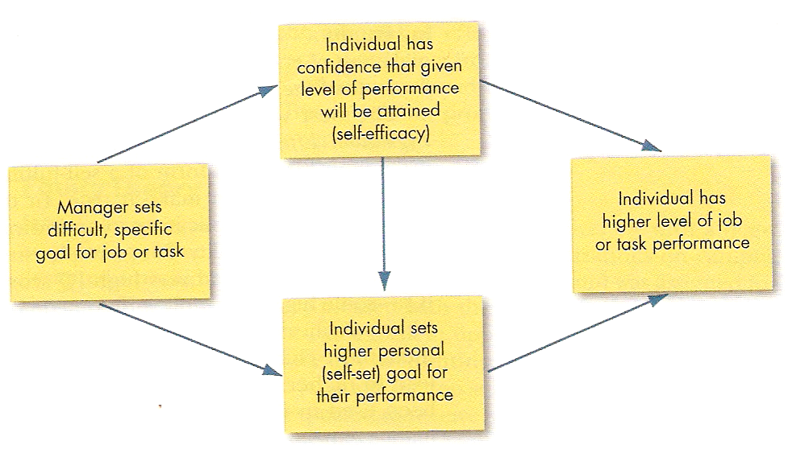
Joint effects of goals and self-efficacy on performance
Notes:
When manager sets a difficult goals for employees (research show that setting difficult goals for people communicates confidence), this lead employees to have higher level of self efficacy and also leads them to set higher goals for their own performance

Slide 84
Reinforcement theory a theory that behavior is a function of its consequences
Reinforcement theory see behavior as being environmentally caused
Reinforcement theory ignores inner state of individual and concentrated to the personal action
Reinforcement theory ignores feeling, attitudes, expectation, and other cognitive variables that are known to impact behavior
Notes:
Counterpoint of goal setting theory
Reinforcement theory see behavior as being environmentally caused
Reinforcement theory ignores inner state of individual and concentrated to the personal action
Reinforcement theory ignores feeling, attitudes, expectation, and other cognitive variables that are known to impact behavior
The behavior engage in at work and the amount of effort you allocate to each task are effected by the consequences that follow from your behavior.

Slide 85
Equity theory a theory that Individuals compare their job inputs and outcomes with those of others and then respond to eliminate any inequities
Outcomes-input ratio
  equal to others → fair, justice prevail
  Under rewarded → Anger
  Over rewarded → guilty
Equally equity
  Change input (as decrease effort)
  Change outcomes (quantity more than quality)
  Distort perception of self
  Distort perception of others
  Choose different referent
  Leave the field
State the impact of under rewarding employees
Notes:
Equity theory
a theory that Individuals compare their job inputs and outcomes with those of others and then respond to eliminate any inequities.
The impact for behavior are:
equal to others → fair, justice prevail
Under rewarded → Anger
Over rewarded → guilty
If employee perceive inequity, the may:
Change input (as decrease effort)
Change outcomes (quantity more than quality)
Distort perception of self (it’s ok, Now, I would like to make my work slower down)
Distort perception of others (may their jobs have change)
Choose different referent (may it make sense, because other had worse the me )
Leave the field (quit the job)

Slide 86
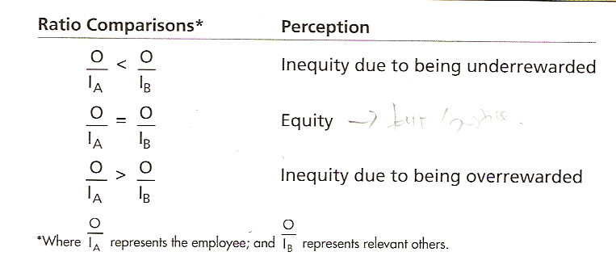
Notes:
Our outcomes devide by Our input compare with Other outcomes divide by their input
If ours less then theirs so it would be percept inequity (we are under rewarded)
If ours more then theirs so it would be percept inequity (we are over rewarded)
Equity will be percept if ours the same as theirs

Slide 87
Equity theory a theory that Individuals compare their job inputs and outcomes with those of others and then respond to eliminate any inequities
 | Payment by time | Payment by quantity
Over rewarded | Produce more | Produce fewer, but higher quality, unit
Under rewarded | Produce less and poorer quality of output | Produce a large number of low quality units
State the impact of under rewarding employees
Un supported these preposition
Inequities created by over payment
Equity sensitivity. Not all people are equity sensitive
Notes:
In the relation to payment, equity percept behavior, are:
If over rewarded are given payment at time they would produce more then will equitably paid one
If under rewarded are given payment at time they would produce less and poorer quality output then will equitably paid one
If over rewarded are given payment by quantity they will produce fewer, but higher quality unit then will equitably paid one
If Under rewarded are given payment by quantity they will produce a large number but in low quality unit then will equitably paid one
But this propositions unsupported by conditions:
Inequities created by over payment
Equity sensitivity. Not all people are equity sensitive

Slide 88
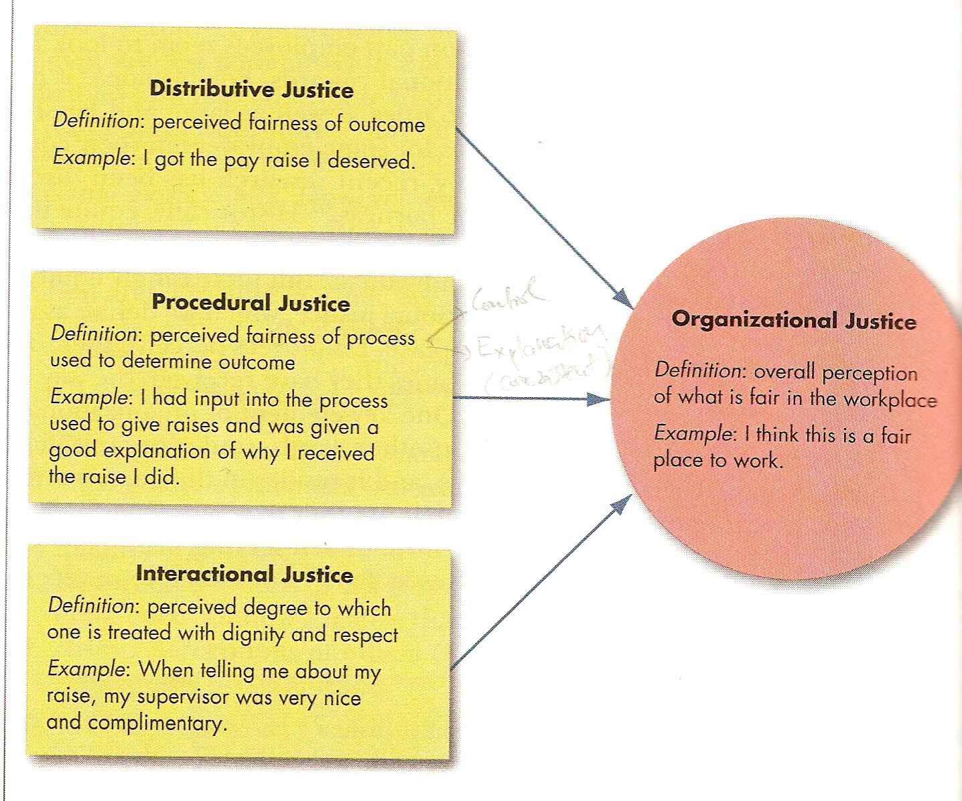
Notes:
Historically, equity theory focused on distributive justice, but the recent time research has been directed at expanding what the mean of equity or fairness. It become organizational justice meant that an overall perception of what is fair in a work place, comprised of distributive justice, procedural justice, and interact ional justice.
distributive justice meant the perceived fairness of amount and allocation of rewards among individual. It mostly related to outcomes satisfaction like pay
procedural justice meant the perceived fairness of the process used to determine the distribution of reward. It related to job satisfaction, employee trust, withdrawal from the organization, job performance, and citizenship behavior.
interact ional justice meant the perceived degree to which an individual is treated with dignity, concern, and respect.

Slide 89
Expectancy theory the strength of tendency to act in a certain way depends on the strength of an expectation that the act will be followed by a given outcome and on the attractiveness of the outcome to the individual (by Victor Vroom)
Effort-performance relationship: Employee will be motivated to exert a high level of effort, when they believe that effort will lead to good performance appraisal
Performance-reward relationship: The degree (good) performance will lead to the attainment of desire outcomes (organizational reward)
Reward-personal goal relationship: degree to Reward, satisfy individual’s personal goal or need and it’s attractiveness for individual
The keys are understanding individual goals, linkage effort-performance, and performance-reward, reward-goal satisfaction.
Clarify the key relationship in expectancy theory
Notes:
Victor Vroom explain the Expectancy theory as the strength of tendency to act in a certain way depends on the strength of an expectation that the act will be followed by a given outcome and on the attractiveness of the outcome to the individual
In the more practical term it said that employee will motivated when they believe the effort will lead to a good performance appraisal. The good performance appraisal will lead to the organizational reward that will satisfy them.
This concept can explain why the employees was not motivated on their job.
There was no guarantee giving maximum effort could be increase performance because skill deficiency, organization may have non performance factors to appraise performance, and the boss like/unlike to employee (bias in appraisal process)
There was no guarantee to good performer to have good reward because of the reward system it self may have seniority factors, cooperation, kissing up the boss behavior
There was no guarantee to have a good reward to attractive personal, because of reward limitation, incorrect assumptions of the management and sub maximized employee motivation
Then the keys are understanding individual goals, linkage effort-performance, and performance-reward, reward-goal satisfaction.

Slide 90
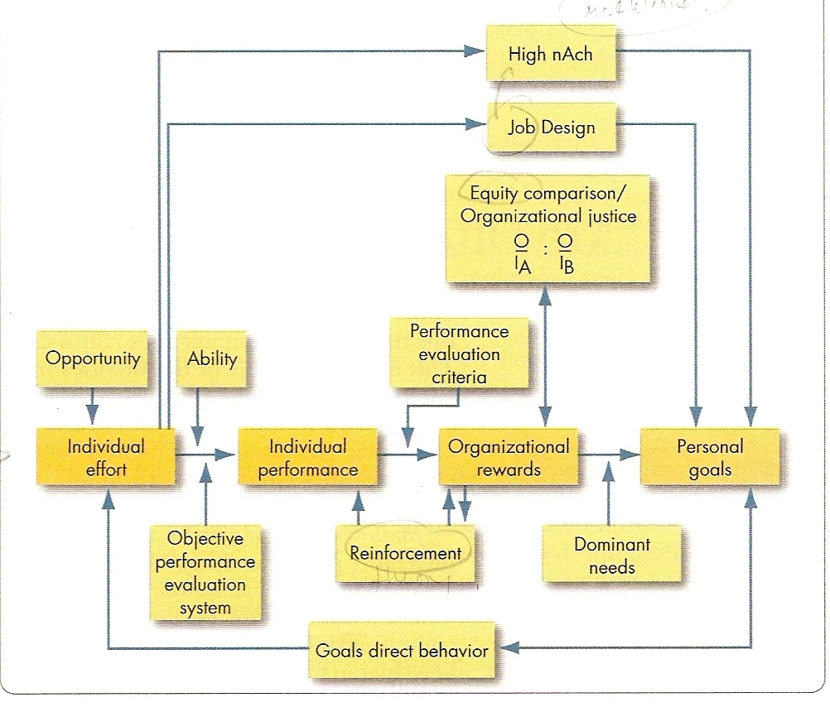
Integrating contemporary theory of motivation
Notes:
All of the theories we have learned, the number of them have been supported only complicates the matter, one each others are not in competition, many of them are complementary one another.
The complementary and its integration may present with expectancy model as a basic foundation.
The individual effort, aid or hinder, may lead to the personal goals.
Consistent with goal setting theory, the individual effort flows to goal direct behavior
Expectancy theory predict that employee will exert a high level of effort, if the perceive there is a strong relationship between effort and performance (that lead by individual ability and fairness of performance appraisal system), performance and reward (if performer have to be rewarded), and reward and satisfaction of personal goals (if consistent of reward received with its personal goals).
McClelland theory. High achievers was motivated by their personal goals (responsibility, feedback and moderate risk) not by organizational performance appraisal or organizational reward.
Reinforcement theory. Support individual performance if the reward design to reinforce them.
Equity. The reward can also play the key part in organizational justice, that individual will judge the favorability of their outcomes to the other one.
Ok Everybody, so far, anyone of you find out some of theories integrate to this figure.

Slide 91
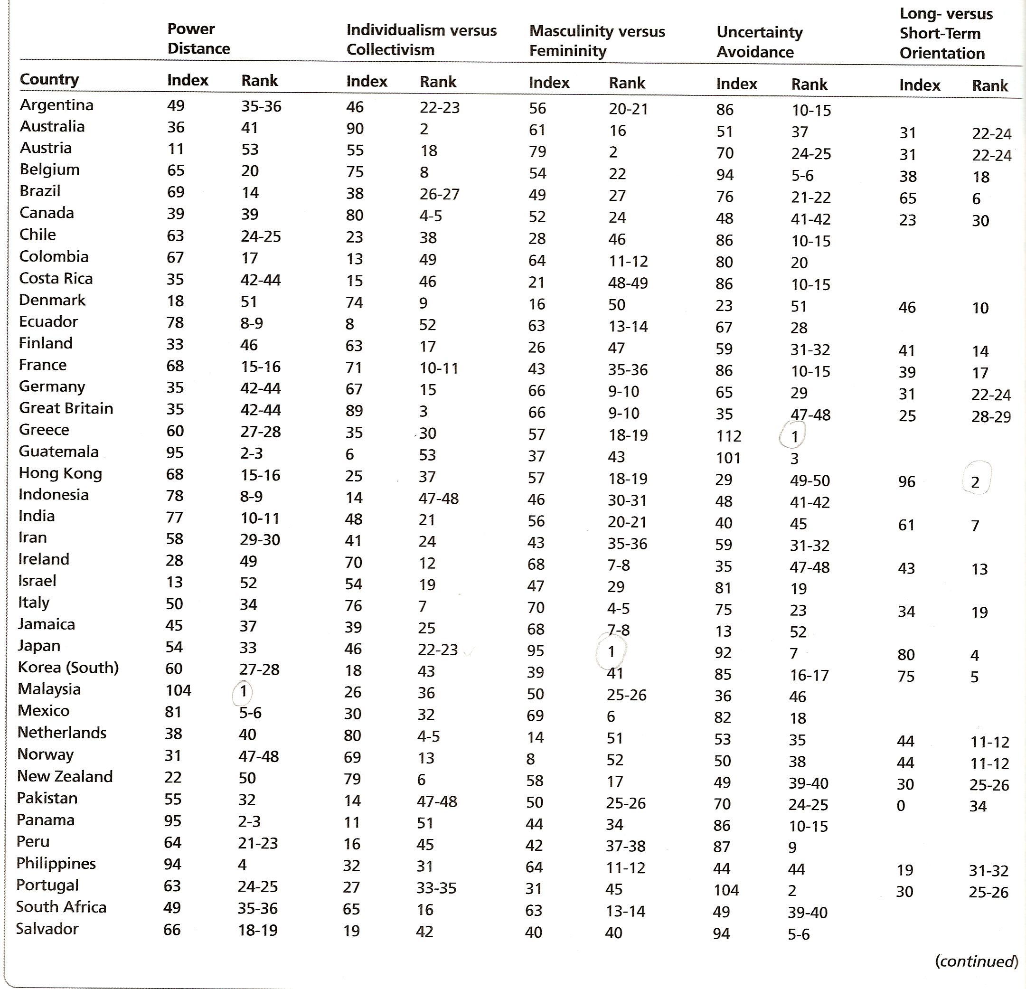
Notes:
And the last one for closing, don’t forget to remember the characteristics of these countries represent their each culture. And the background of the theories supported. So than we can apply this concept effectively, and relevant to the objects.
For the examples:
Maslow theory find the self actualization as a highest level of motivation, it will be different in Japan, Greece and Mexico that have uncertainty avoidance characteristic that have security needs in the top of motivation, so do with the nurturing country like Denmark, Sweden, Norway, Netherland and Finland, would have social need of the top level of satisfaction.
McClelland theory it will be the same in US-Canada and Great Britain. But not in Chile and Portugal
Equity theory may different and need modification to apply in Rusia and former communist country.
And how about in taiwan?

Slide 92
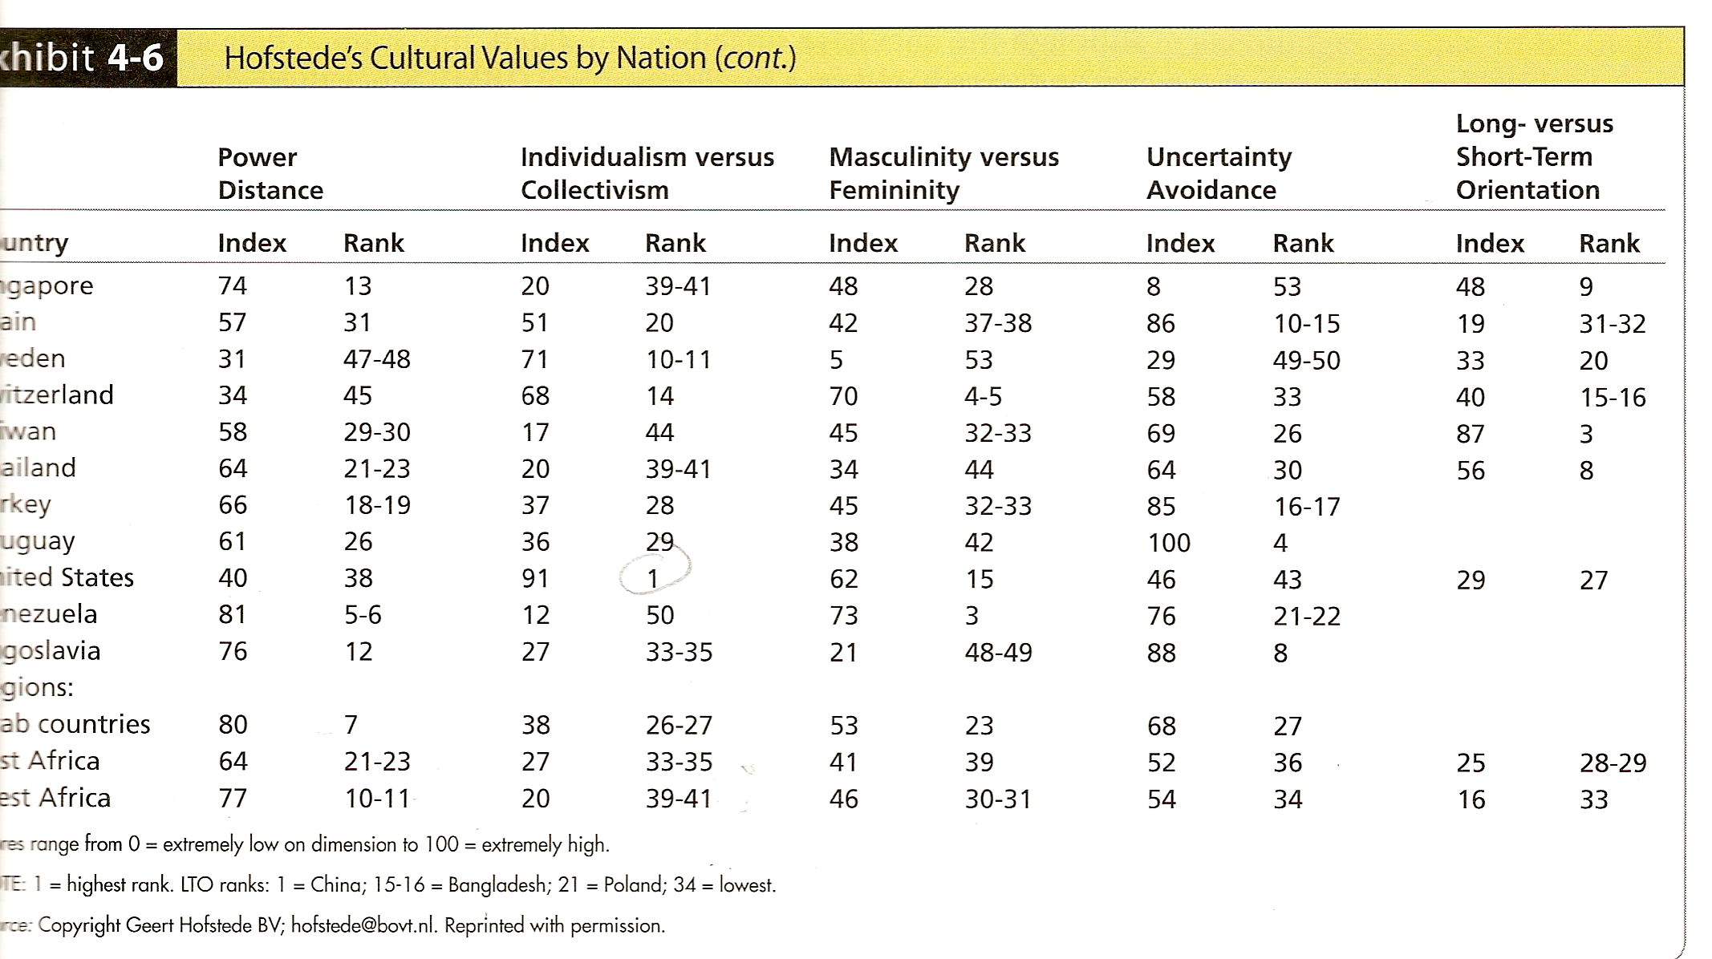
Notes:
Ok. That’s all. Thanks for your attention. I’m sure there are many mistake in my presentation, an may make you all boring. I’m so sorry. Again thanks for your inputs and suggestion. Hope in another opportunities it will be better. Thank you.

