Slide 1
37 minutes to work (open book only)

Slide 2
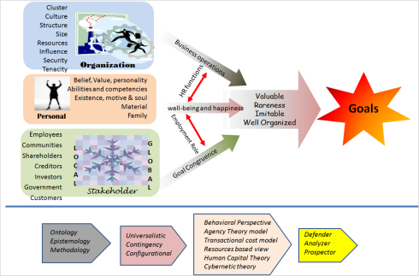
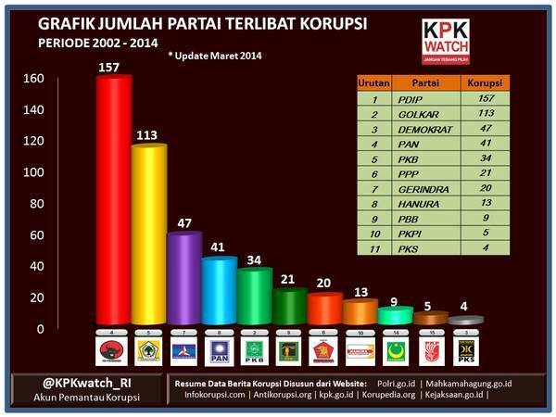
Please explain these figures by using the HRMS perspectives
80%
1
2
37 minutes to work (open book only)
20%

